Slide 1
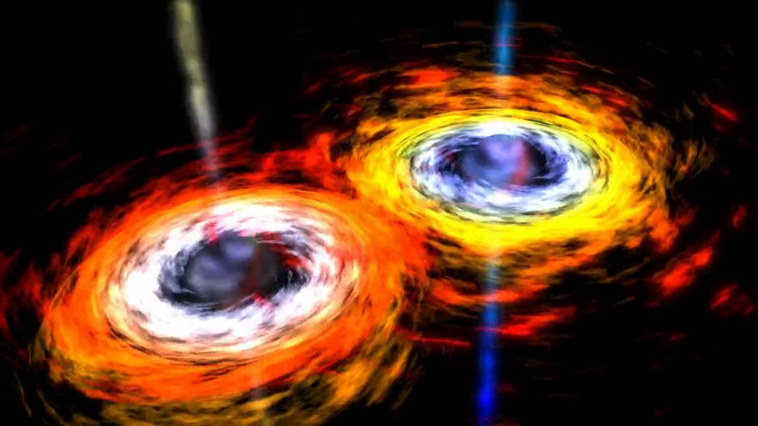
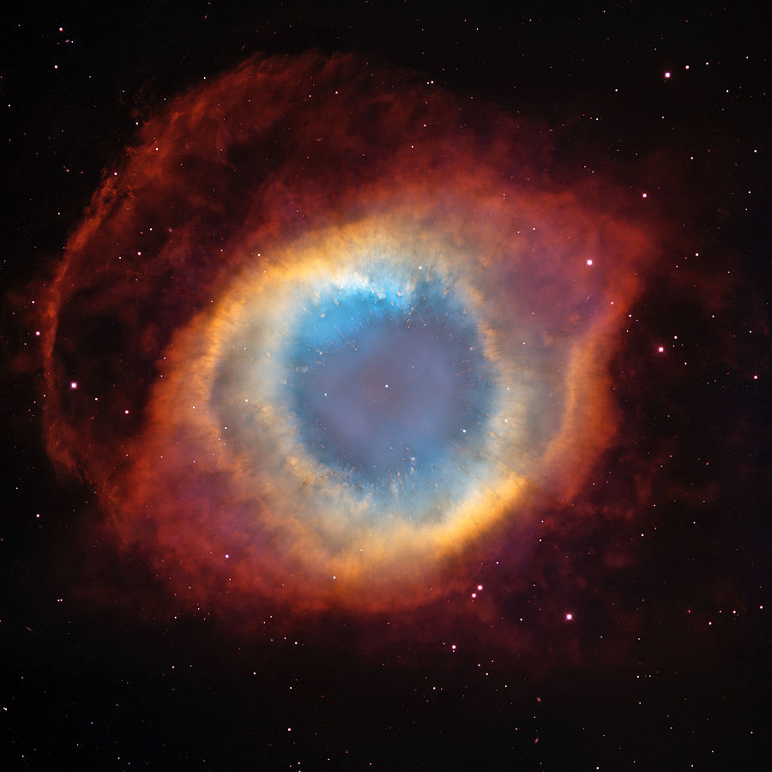
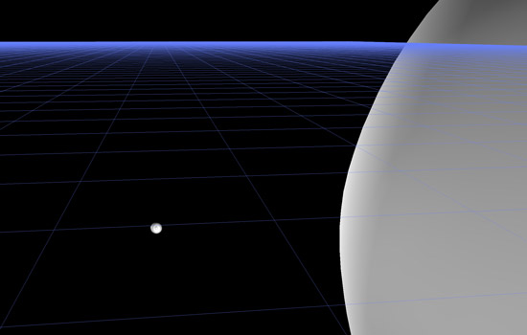
Gravitational Waves – Sources and Detectors
Orbiting Massive Bodies
Supernova, NGC7293-Helix Nebula
Extreme Mass Ratio Blackhole Mergers
https://www.rit.edu/news/story.php?id=47936

Slide 2
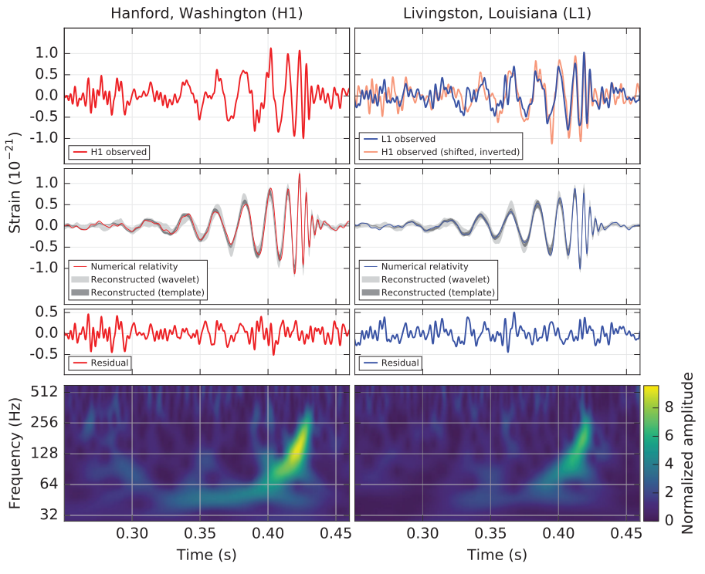
Gravitational Wave GW150914
Direct Observation by LIGO of a gravitational wave. Announced on 11 February 2016 for a wave on 14 September 2015---event labeled GW150914.
SNR = 24, so a greatre than 5 sigma detection!
Pretty after filtering out the known seismic noise frequencies.
First at L1 and 6.9ms later at H1.

Slide 3
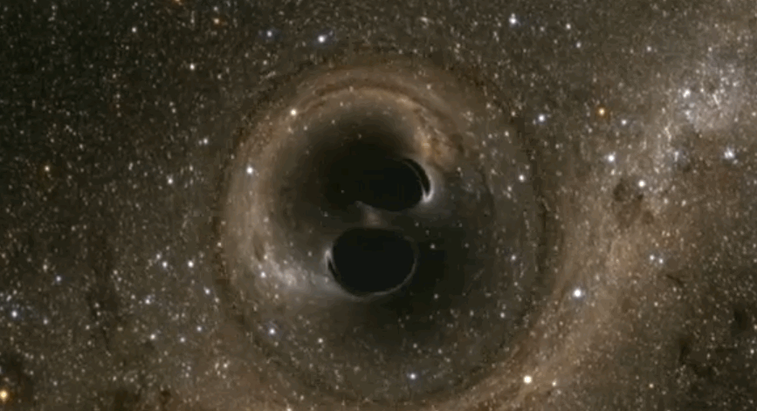
Merging Black Holes
ref: http://www.techinsider.io/binary-black-holes-confirmed-gravitional-waves-2016-2

Slide 4
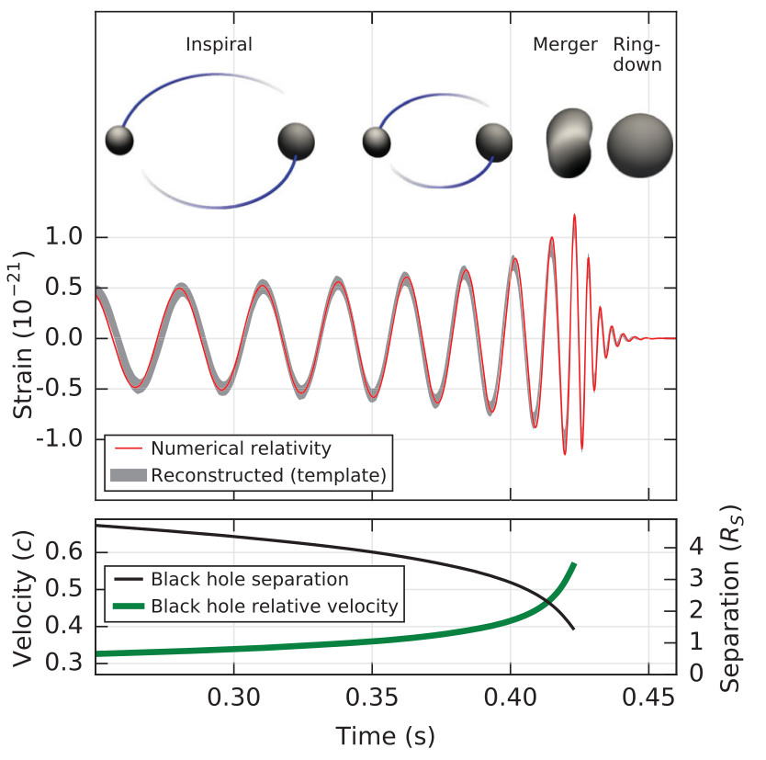
Interpretation as a Binary Black Hole Merger
GW150914 signal is best fit with the model of a 36 Msun and 29 Msun black hole coalescing into a 62 Msun BH. Radiated 3 Msuns of energy into the GW.
About 410 Mpc away, 1.3 billion ly.
Also the discovery of Black Holes!
Oddly heavy BHs compared to best ideas on how BHs are created/formed.
Ref: https://losc.ligo.org/events/GW150914/

Slide 5
Second Direct Detection GW151226 and “trigger” LVT151012
Second Direct Detection by LIGO called GW151226 which occurred on Chirstmas Day, 2015, in the USA.
SNR = 11 (LHO) and 8 (LLO), so not as pretty, greater than 5 sigma significance (it could happen by chance).
14 Msun BH orbiting 7.5 Msun BH
21 Msun BH final, radiated about 1 Msun in GW
440 Mpc away (+180 Mpc -190 Mpc)
Third event called LVT151012. Called a “trigger” or “candidate.”
SNR = 9.7, and significance of 1.7 sigma.
23 Msun BH orbiting 13 Msun BH
35 Msun BH final, radiated about 1 Msun in GW
Ref: 15 June 2016 press conference.
https://losc.ligo.org/events/LVT151012/
https://losc.ligo.org/events/GW151226/

Slide 6
More about LIGO Tomorrow morning.

Slide 7
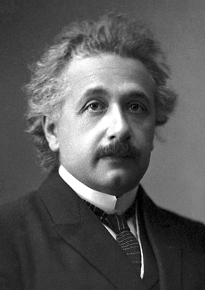
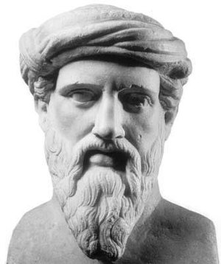

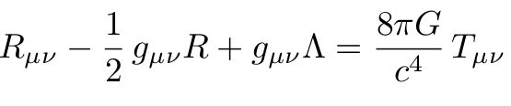
General Relativity is used to describe gravity...spacetime.
Thank you, again, Albert Einstein!
GR has a function that lets you calculate distances in spacetime...the metric. Think Pythagoras!
Find the metric by solving Einstein’s Field Equations...just a set of nonlinear, coupled, second order partial differential equations.
Matter and Energy,
it is what curves space.
Geometry, derivatives
of the metric.
Accelerating
Expansion

Slide 8


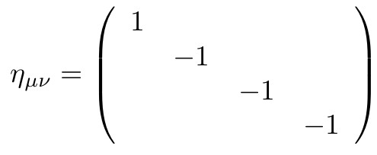

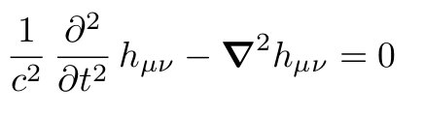
Gravitational Radiation predicted by Einstein in 1916
Einstein predicted the wave-like behavior of small perturbations to the metric in his 1916 paper. The formula for masses was corrected by another physicist later (factor of 2?). Oddly Einstein and his assistants decided it could not exist around 1936 and wrote many papers saying so.
Linearized General Relativity
Like that in the Special Theory of Relativity,
Minkowski metric/matrix. Gives invariant:
Linearized General Relativity yields the
wave equation in the small perturbation.
Ref: Kennefick, Traveling at the Speed of Thought, 2007.

Slide 9
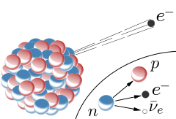
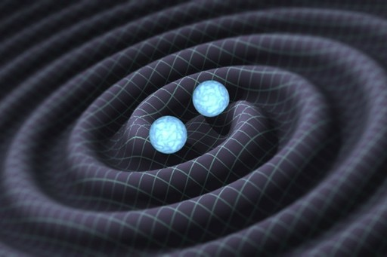
Gravitational Waves and Neutrinos
History of Discovery in physics not always quick nor easy. Compare the prediction of Neutrinos and Gravitational Waves.
Neutrinos:
Postulated by W. Pauli in 1930.
To explain energy, momentum, and spin conservation in beta decay.
Direct observation not unitl 1956 by Cowan and Reines. Nobel Prize in 1995.
Gravitational Waves:
Consequence of GR, A. Einstein 1916.
Long, sordid debate on its existence and nature---even in 1970 when most agreed it existed many believed orbiting bodies were protected from Grav. Waves.
Discovery of Pulsar PSR1913+16 by Hulse and Taylor in 1974, eventually showed orbit energy loss and perihelion precession consistent with GWs. Nobel 1993.
Direct detection by LIGO in 2016.

Slide 10



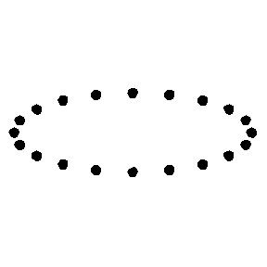
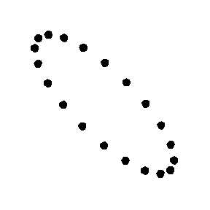
Nature of Gravitational Waves, and
Of all 10 possible components to h, it simplifies to two polarizations. One with a motion that shrinks (grows) in one direction while growing (shrinking) in the other direction. The other polarization is just rotated by 45 degrees.
hplus polarization
hcross polarization
Wave headed into the page, Y up, X right.

Slide 11
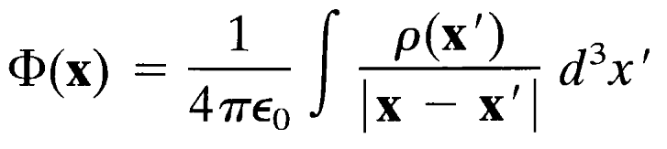

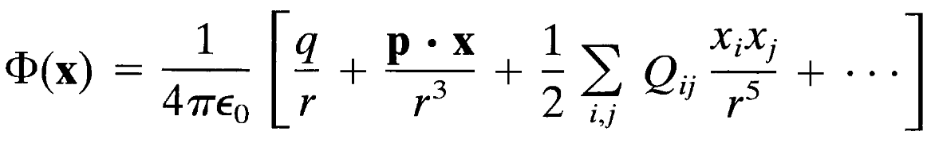
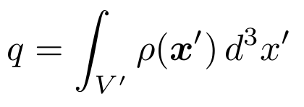
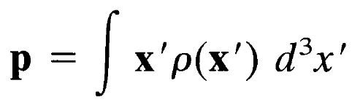
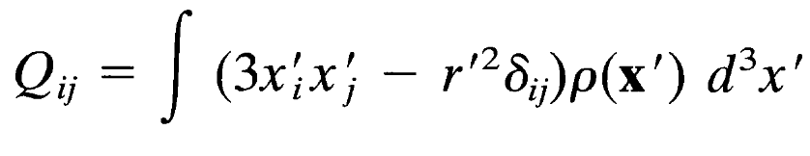
Multipoles - Electrostatic Potential Energy
Multipole expansion when far from a complicated source, .
Monopole Moment
Dipole Moment
Quadrupole Moment
Ref: Jackson, Classical Electrodynamics

Slide 12


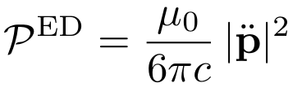
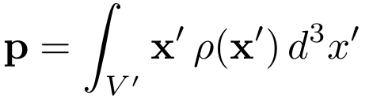
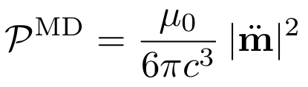
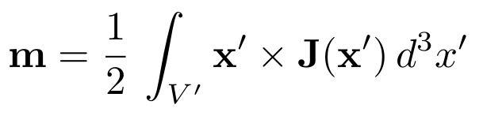
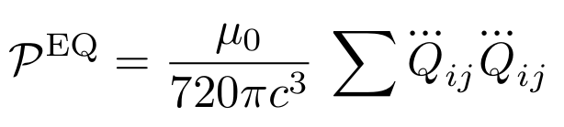
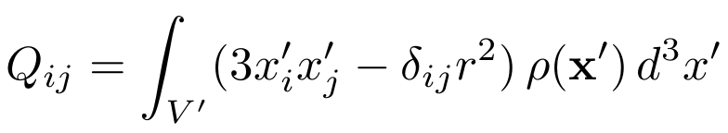
Multipoles – EM Radiation
Multipole expansion for electromagnetic radiation, when the source has charge changing in time. is the charge distribution (later for GW it will be the mass distribution!).
Charge is conserved, dq/dt = 0.
Monopole Moment
First non-zero term.
Electric Dipole Moment
Magnetic Dipole Moment
Electric Quadrupole Moment
Ref: Brau, Modern Problems in Classical Electrodynamics

Slide 13
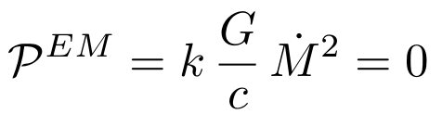
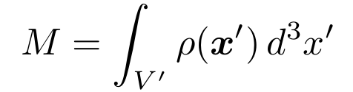
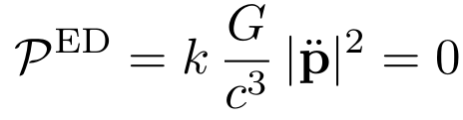
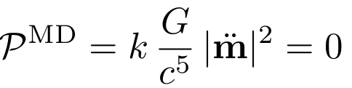
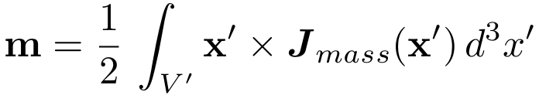
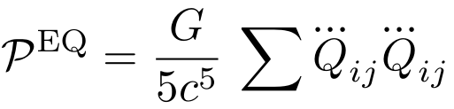
Quadrupole Moment
Now is the mass distribution of the source.
Mass is conserved, dM/dt = 0.
Monopole Moment
Center of Mass
does not change.
Electric Dipole Moment
Angular Momentum
does not change.
Magnetic Dipole Moment
Electric Quadrupole Moment
First non-zero moment! Quadrupole
Ref: Misner, Thorne, and Wheeler, Gravitation

Slide 14

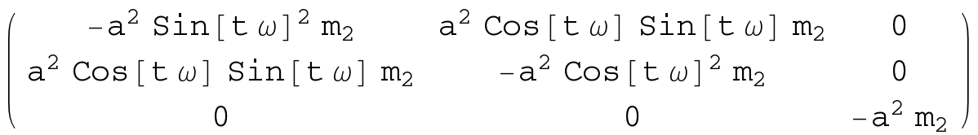

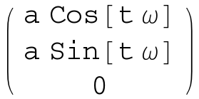
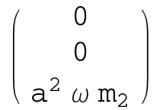
Quadrupole Moments
m1
m1 fixed and m2 in circular orbit
quadrupole moment is:
m2
monopole moment is: m1+m2
dipole moment is:

Slide 15
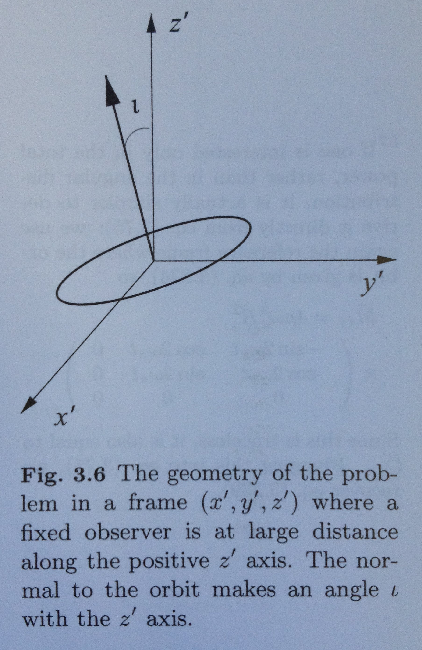

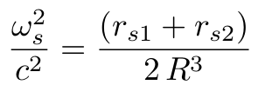


GW strain for Circular Orbit
rs1 is 2GM_1/c^2, Schwarzschild radius for
mass M_1, etc.
r is distance from Earth to system.
R is the separation of the two bodies.
ref: Maggiore around Eqn. 3.332.

Slide 16
Strain for binary system GW150914
Now work it for our GW150914, 36 Msun, 29 Msun, at distance of 410 Mpc (1.3 billion ly),
And separation of how much?
Check the strain on slide 2.

Slide 17
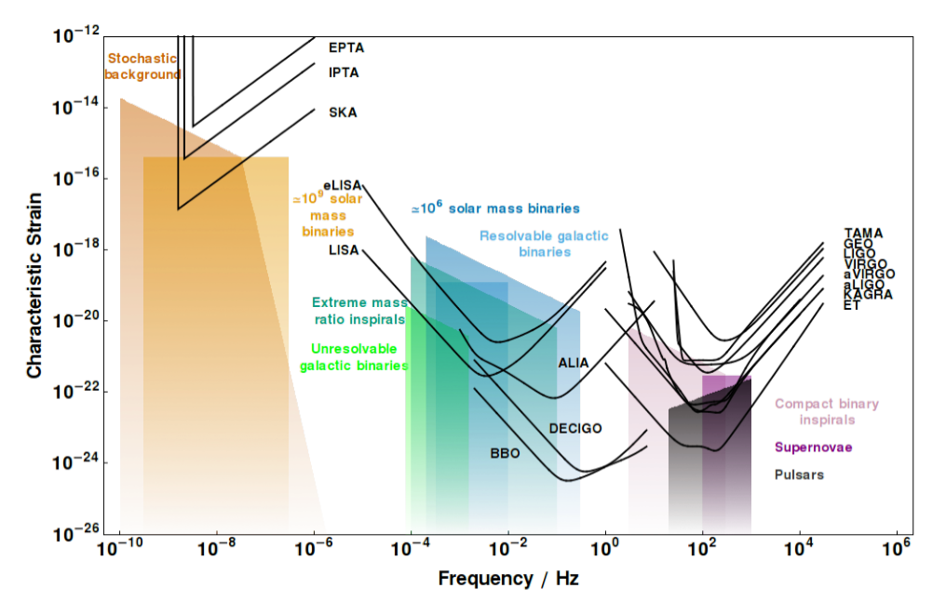
Strain Curves from Moore et al.
Pulsar Timing Arrays
Spaced-based
Ground-based
Notes:
http://www.ast.cam.ac.uk/~cjm96/noise_curve.pdf

Slide 18
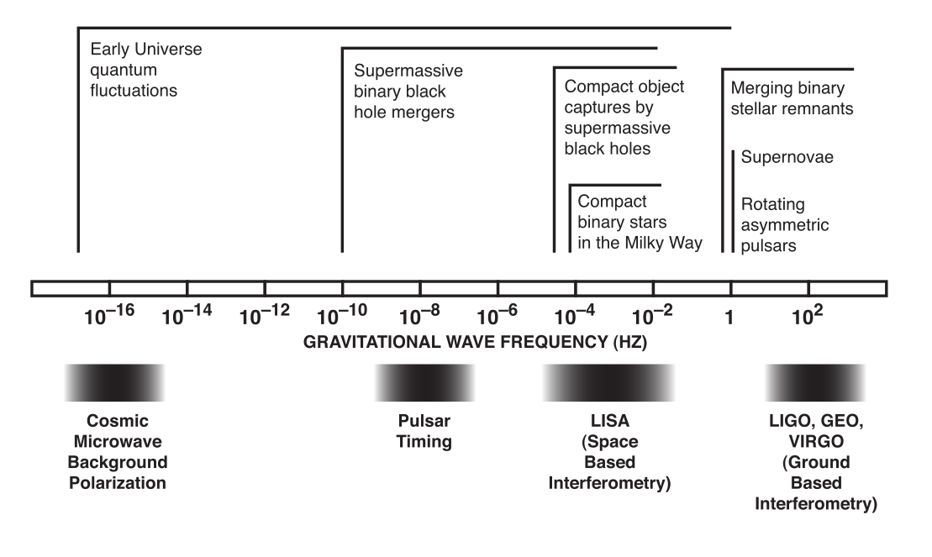
Gravitational Wave Spectrum

Slide 19
Ground-Based, aka aLIGO
Both interferometers using light as a clock to measure the change in lengths.
More tomorrow:)
Besides interferometers there are also still “bars.”

Slide 20
Space-Based, aka LISA
Laser Interferometer Space Antenna, LISA, is a set of satellites with lasers bouncing in a triangle arrangement.
  No seismic effects!
  Very long baseline, 5e9 m or 1e9 m each leg.
  Control of craft suble, “drag-free flying” with free test mass inside as reference.
Currently mostly European eLISA with some NASA/US support. eLISA could launch in 2032.
LISA Pathfinder satellite experiment tested several components for eLISA, early 2016.

Slide 21
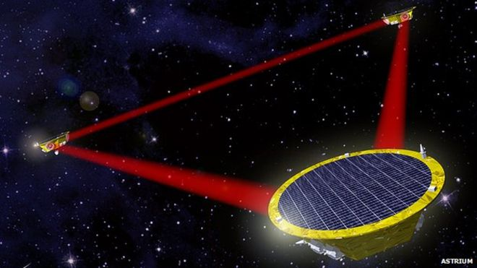
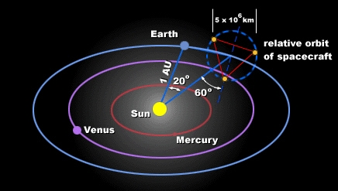
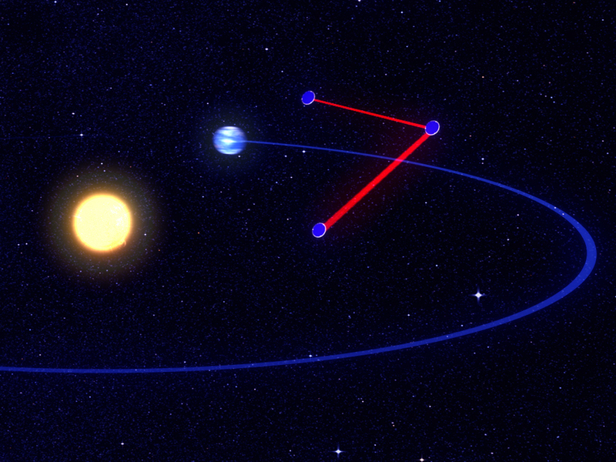
LISA and eLISA
LISA has a full equilateral triangle of lasers and baseline of 5e9 m. Not funded.
eLISA uses two legs of the equilateral triangle of lasers and baseline of 1e9 m. Successful LISA Pathfinder mission and LIGO detection means likely to go forward and maybe “fast-tracked.”

Slide 22
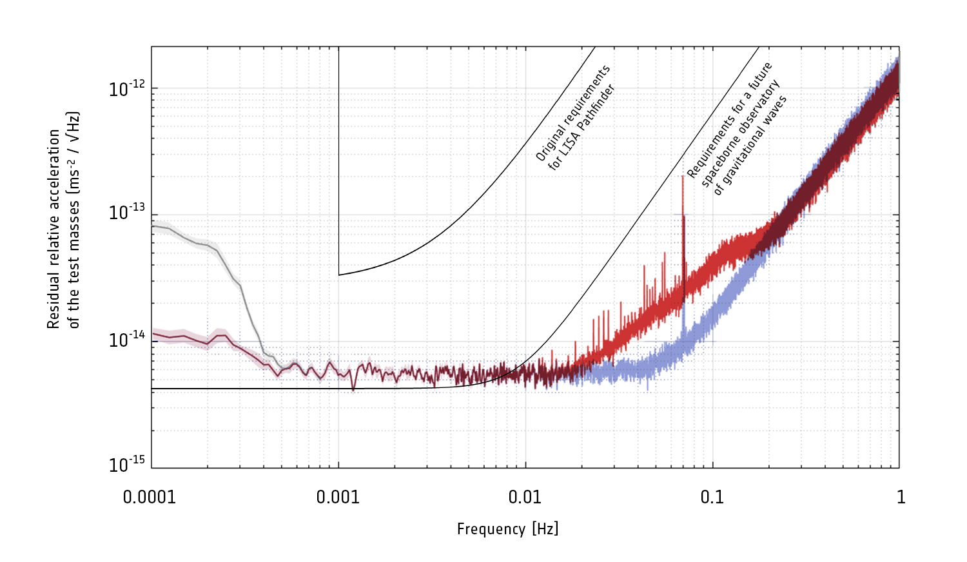
LISA Pathfinder
LISA Pathfinder successfully demonstrated the technologies for “drag-free” flight of the eLISA space craft.
  Orbit is nearly freely falling around the sun.
  Microthrusters used to counter solar wind, etc, and allow a free mass inside to react only to gravity!
Measured relative acceleration as good as 6e-15 m/s^2 per root Hz (tomorrow).

Slide 23
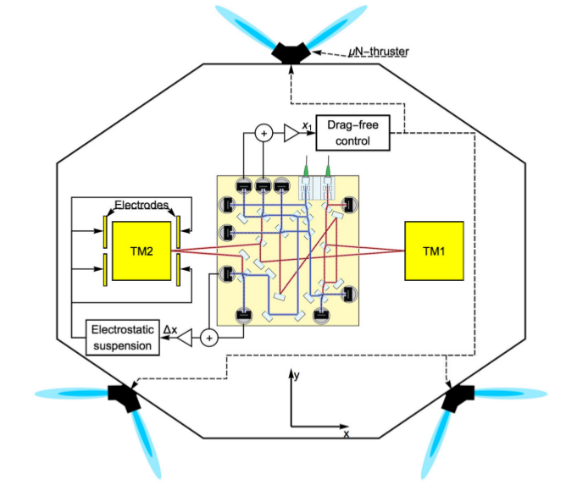
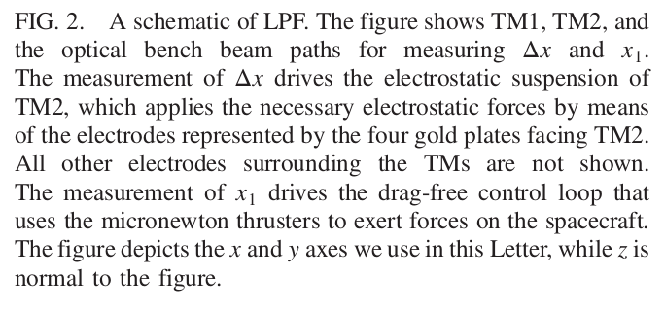
LISA Pathfinder
Ref: Armano et al., PRL 2016

Slide 24
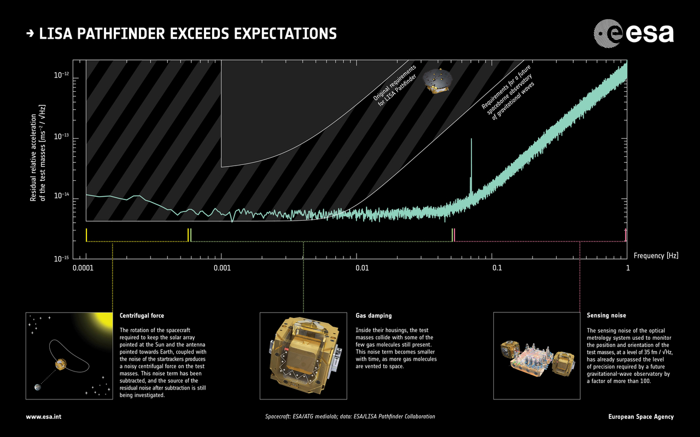
LISA Pathfinder

Slide 25
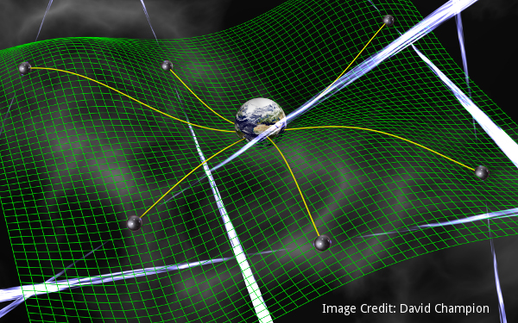
Pulsar Timing Arrays
Millisecond pulsars are very good clocks scattered around the Universe.
By measuring them once in a while, you can detect a hiccup in the reception of the pulse at Earth. With enough “clocks” you can decide if there was a gravitational wave and from where it may have come.
See chart, sensitive to very, very long wavelengths, and thus very, very small frequences. Size of the Universe sort of waves!
Ref: NANOGrav collaboration

Slide 26
Pulsar Timing Arrays
Several collaborations working at radio astronomy facilities to measure millisecond pulsars:
NANOGrav, US and NASA, using Arecibo and Green Bank.
The International Pulsar Timing Array uses many radio telescopes.
The European Pulsar Timing Array
and others.

Slide 27
Links
CalTech GW media assets page.
Kelly Holley-Bockelman’s TEDx Nashville Talk 2016 about GW150914.
Pulsar timing array, Nanograv

Slide 28
Backup

Slide 29
Some Constants
Schwarzschild radius | 2GM/c^2 | 2953 m for Msun
GR Units, Mass | GM/c^2 | 1477 m for Msun
GR Units, Power | c^5/G | 3.628e52 W
GR Units, Energy | c^4/G | 1.210e44 J/m
parsec, pc |  | 3.09e16 m = 3.262 ly
astronomical unit, au |  | 149.6e9 m
light-year, ly |  | 0.946e16 m = 0.307 pc
fine structure constant | e^2/(4pi eps0)/hbar c | 0.00730 = 1/137.04
wavelength-energy | h c | 1.24 eV μm

Slide 30
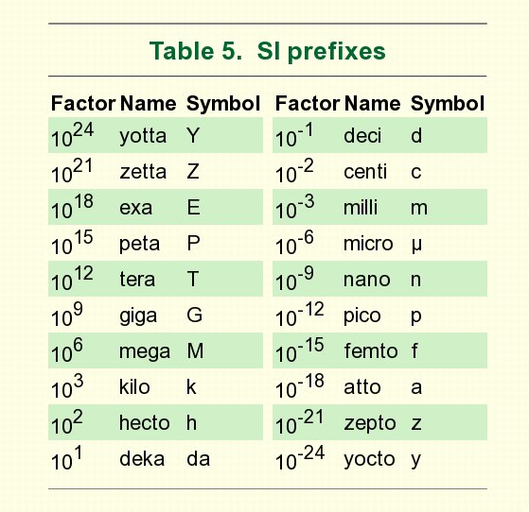
SI Prefixes

Slide 31
aa
aa

Slide 32
Feynman’s Take on Gravitational Radiation
Consider the spin of the “graviton”---the postulated particle that carries the gravitational force.
Generically a spin 1 particle is just like electromagnetism, that is like particles repel and opposites attract. This is NOT what we see in gravity. Just one “charge” and they always attract.
  True for all odd spin particle theories.
So consider spin 0 in some detail, we find that two hot gas clouds are attracted to each other less than those same clouds if they were colder. Yet they have more energy when hot.
So that leaves spin 2. That gives rise to a quadrupolar source for radiation.

