Slide 1
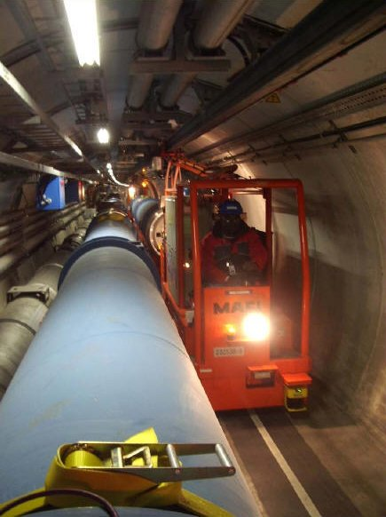
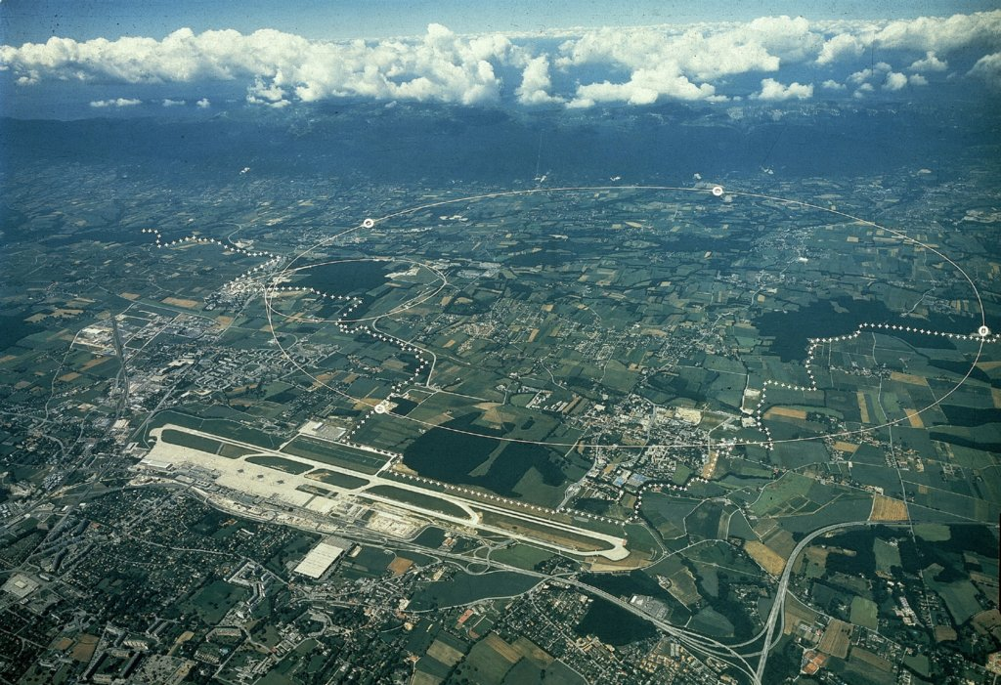
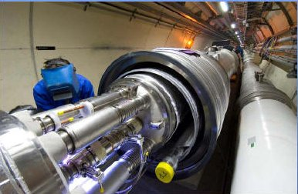
CERN’s Large Hadron Collider
Ref: www.cern.ch

Slide 2
CERN’s Large Hadron Collider
The highest energy collider:
proton on proton collider
center-of-mass energy is now 13 TeV
each counter rotating beam proton beam is 6.5 TeV
each bunch contains 1.2e11 protons
each beam has 2076 bunches (maybe 2064 collide)
Ref: www.cern.ch

Slide 3
Upgrades during LS1, 2013-14
Ref: L. Ponce Annecy 2013

Slide 4
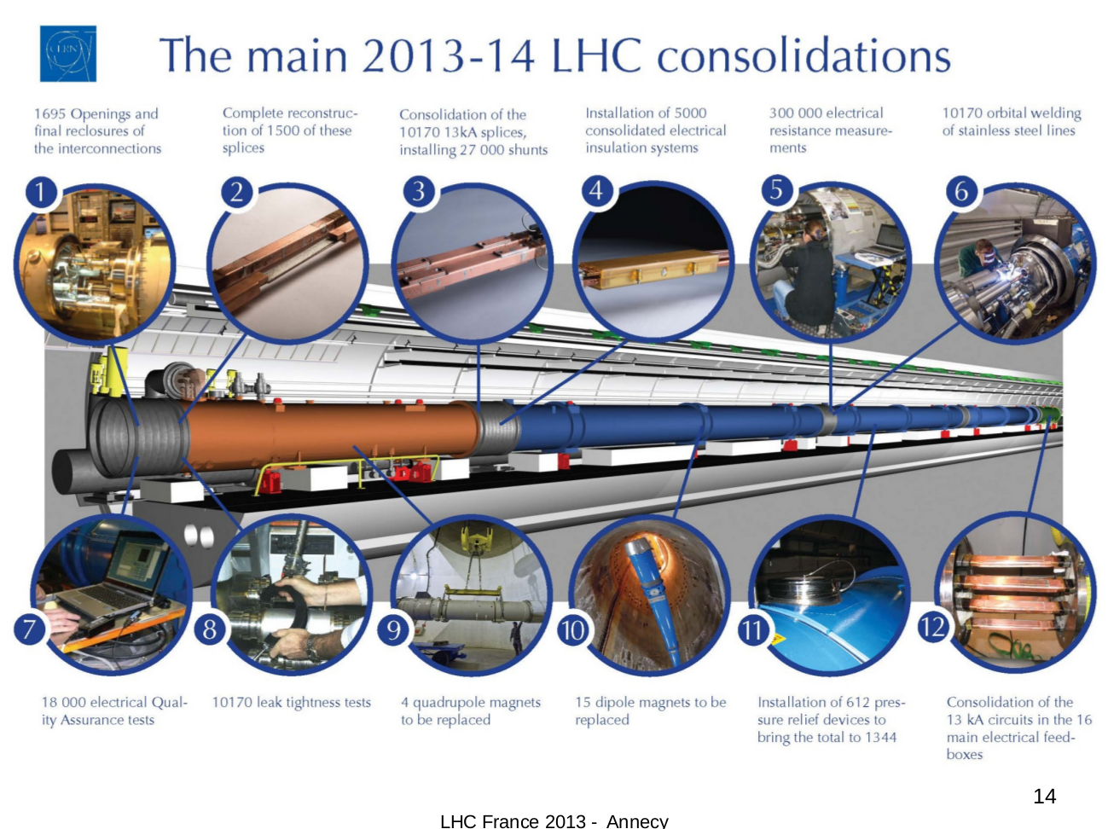
Ref: L. Ponce Annecy 2013

Slide 5
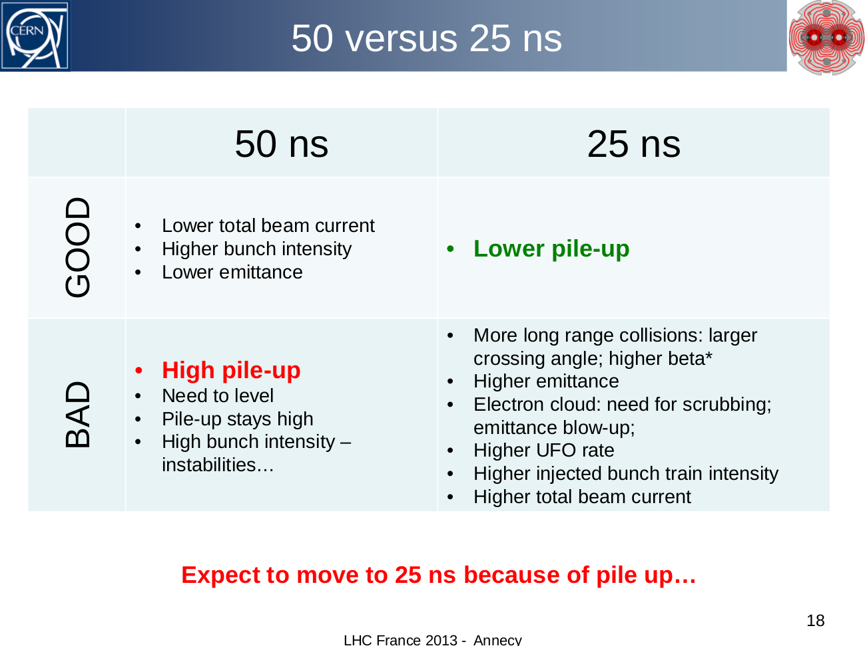
Ref: L. Ponce Annecy 2013

Slide 6
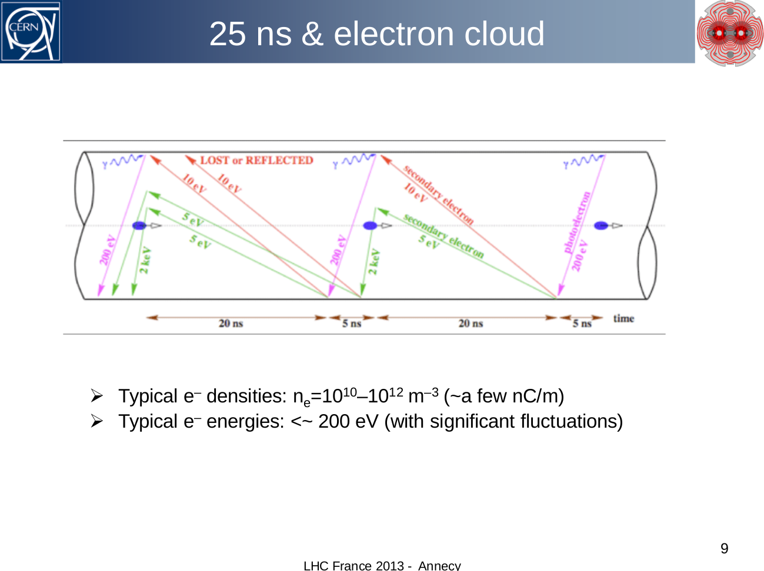
Ref: L. Ponce Annecy 2013

Slide 7
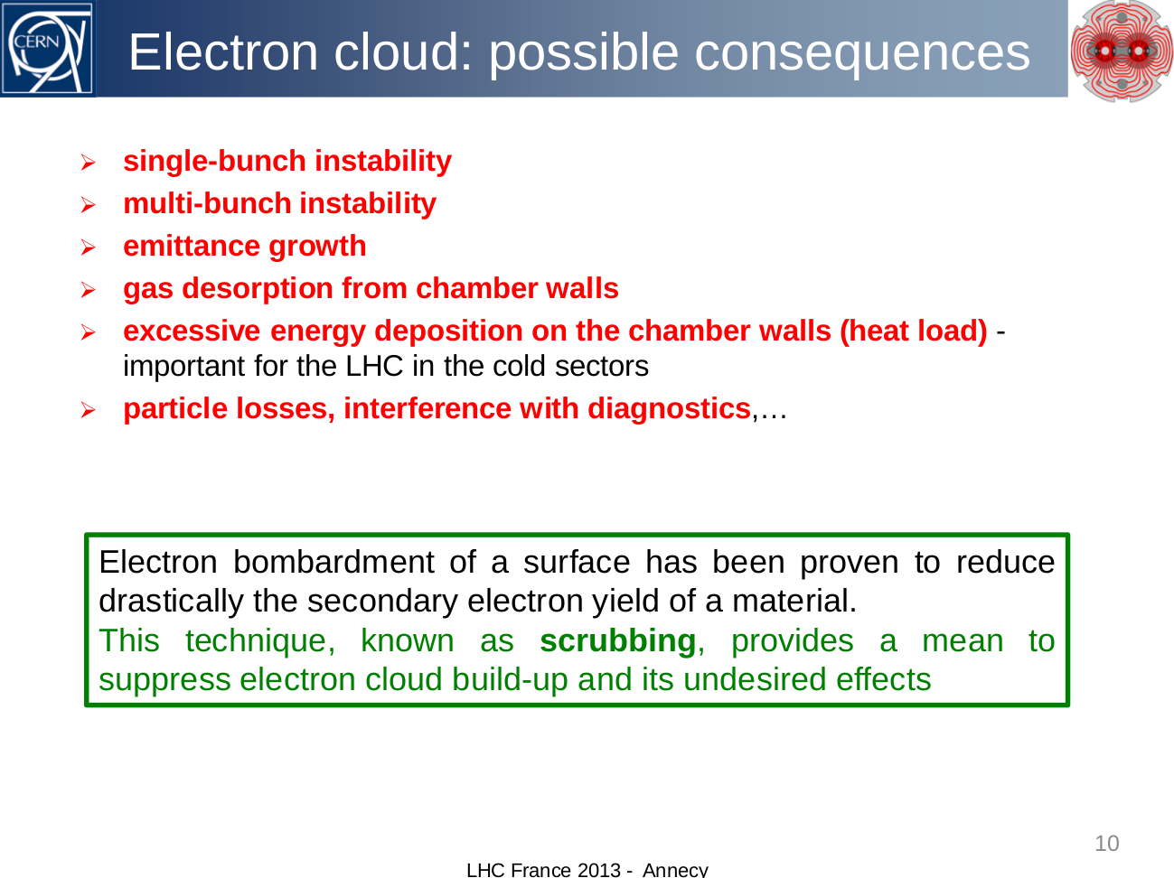
Ref: L. Ponce Annecy 2013

Slide 8
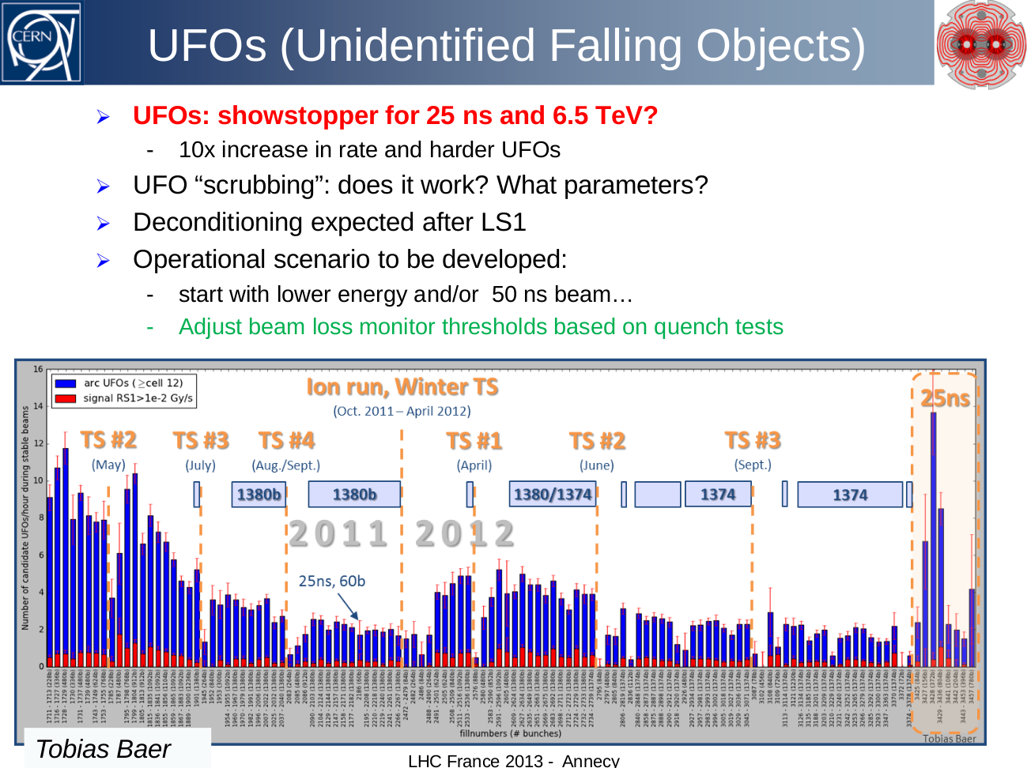
Ref: L. Ponce Annecy 2013

Slide 9
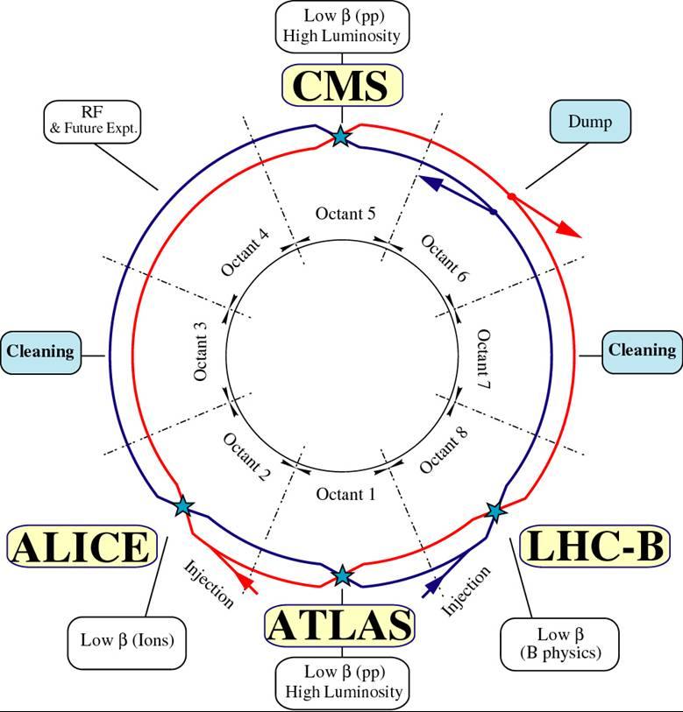
What has the LHC done?
Energies & Modes:
Proton-Proton
2011 3.5+3.5 TeV
2012 4+4 TeV
1380 on 1380 bunches
2013 Long Shutdown 1
2015 6.5+6.5 TeV
Lead-208 (82+)-
Lead
2011 1.38+1.38 TeV/u
2012 none (?)
358 on 358 bunches
Proton-Lead
2013 4.0+1.577TeV/u
338 on 338 bunches

Slide 10
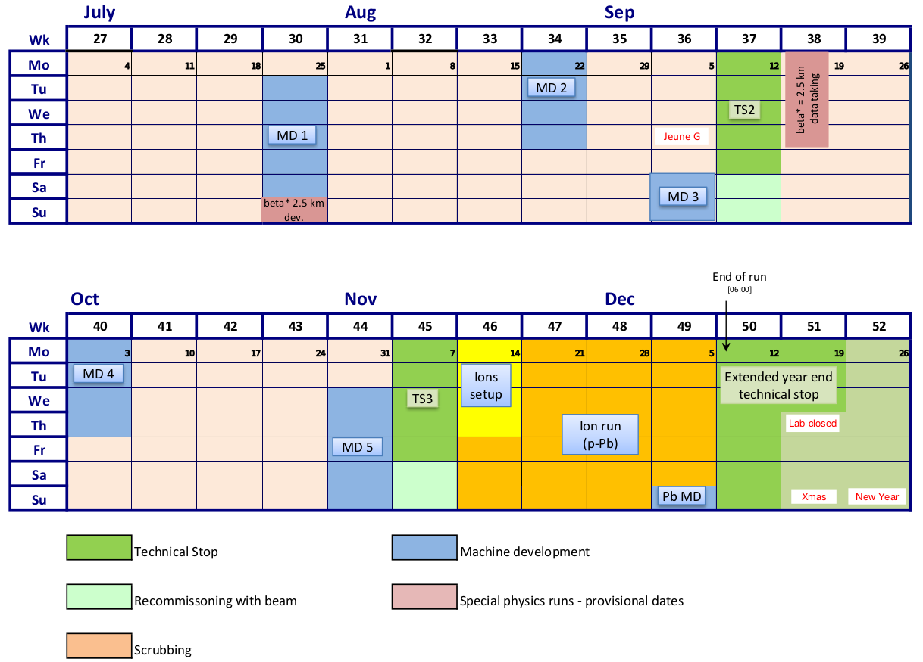
LHC Schedule, July-December 2016
July 2, 2016 v1.9

Slide 11
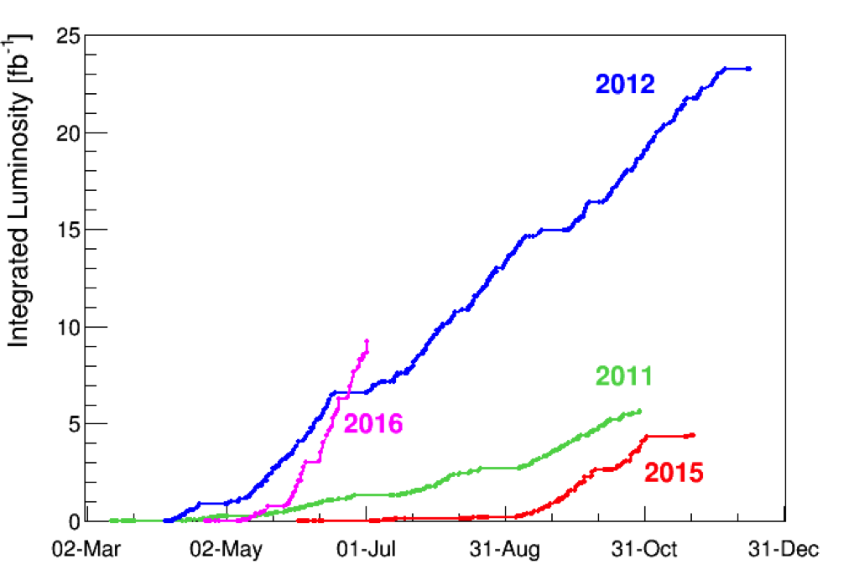
LHC Integrated Luminosity
This graph shows the integrated luminosity delivered by the LHC to the ATLAS and CMS experiments in 2011, 2012, 2015 and 2016. The integrated luminosity indicates the amount of data delivered to the experiments and is measured in inverse femtobarns. One inverse femtobarn corresponds to around 80 million million collisions.
8e13 collisions
Ref: lhc-performance-reaches-new-highs

Slide 12
Some dates from the LHC timeline:
27 April 2007- Last LHC dipole magnet lowered underground.
29 Feb 2008 – Final large detector piece lowered, ATLAS.
10 Sep 2008 – LHC starts up.
19 Sep 2008 – Incident at the LHC.
30 April 2009 – Final repaired magnet goes underground. 53
magnets repaired.
20 Nov 2009 – Beams back in the LHC. 2.36 TeV collisions
in December. Highest energy at that time.
30 Mar 2010 – First collisions at 7 TeV.
18 Oct 2011 – End of the 2011 Proton collision run.
5 April 2012 – Highest energy collisions at 8 TeV.
4 July 2012 – CMS and ATLAS announce “particle consistent
with Higgs boson.”
Jan 2013 – Proton-Lead collisions and Proton-Proton at 1.38 TeV.
16 Feb 2013 – End of LHC Run 1. Start Long Shutdown 1.
8 Oct 2013 – Nobel prize for Englert and Higgs for Higgs boson.
3 June 2015 – Proton collisions at 13 TeV start.

Slide 13
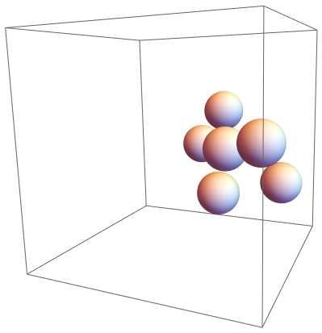

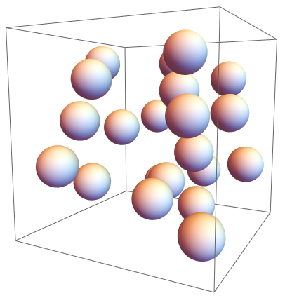
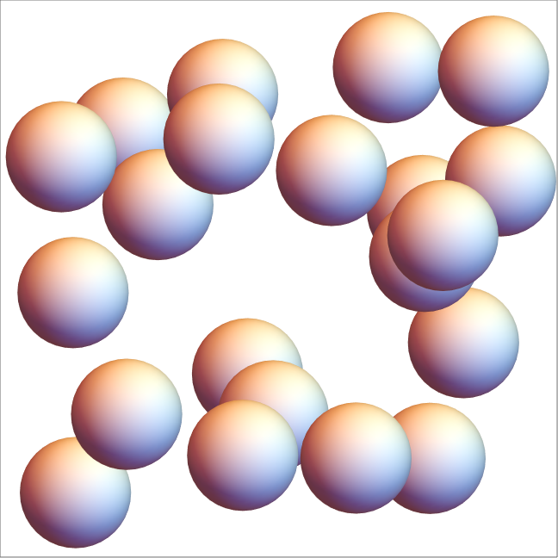
Cross-Section for Interactions
Physical or Effective size and density decide how many times you will interact for each crossing of the box.

Slide 14
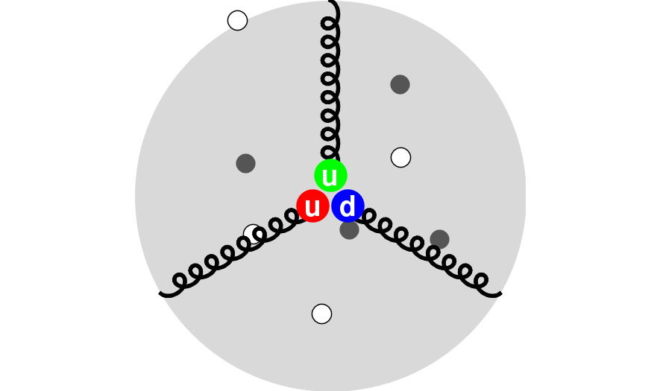
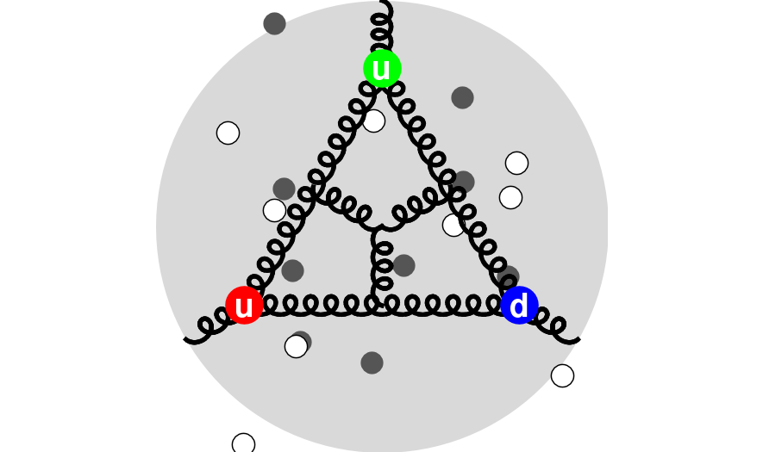
Proton is not a simple object.
Protons are bags of valence quarks, gluons, and virtual
quarks. Proton is a u-u-d valence quark combination,
the “intrinsic mass” of the u is 1.9 MeV/c^2 and the d is
4.6 MeV/c^2 (an electron’s rest mass is 0.511 MeV/c^2).
Yet the mass of the proton is 940 MeV/c^2 !
Ref: www.cern.ch

Slide 15
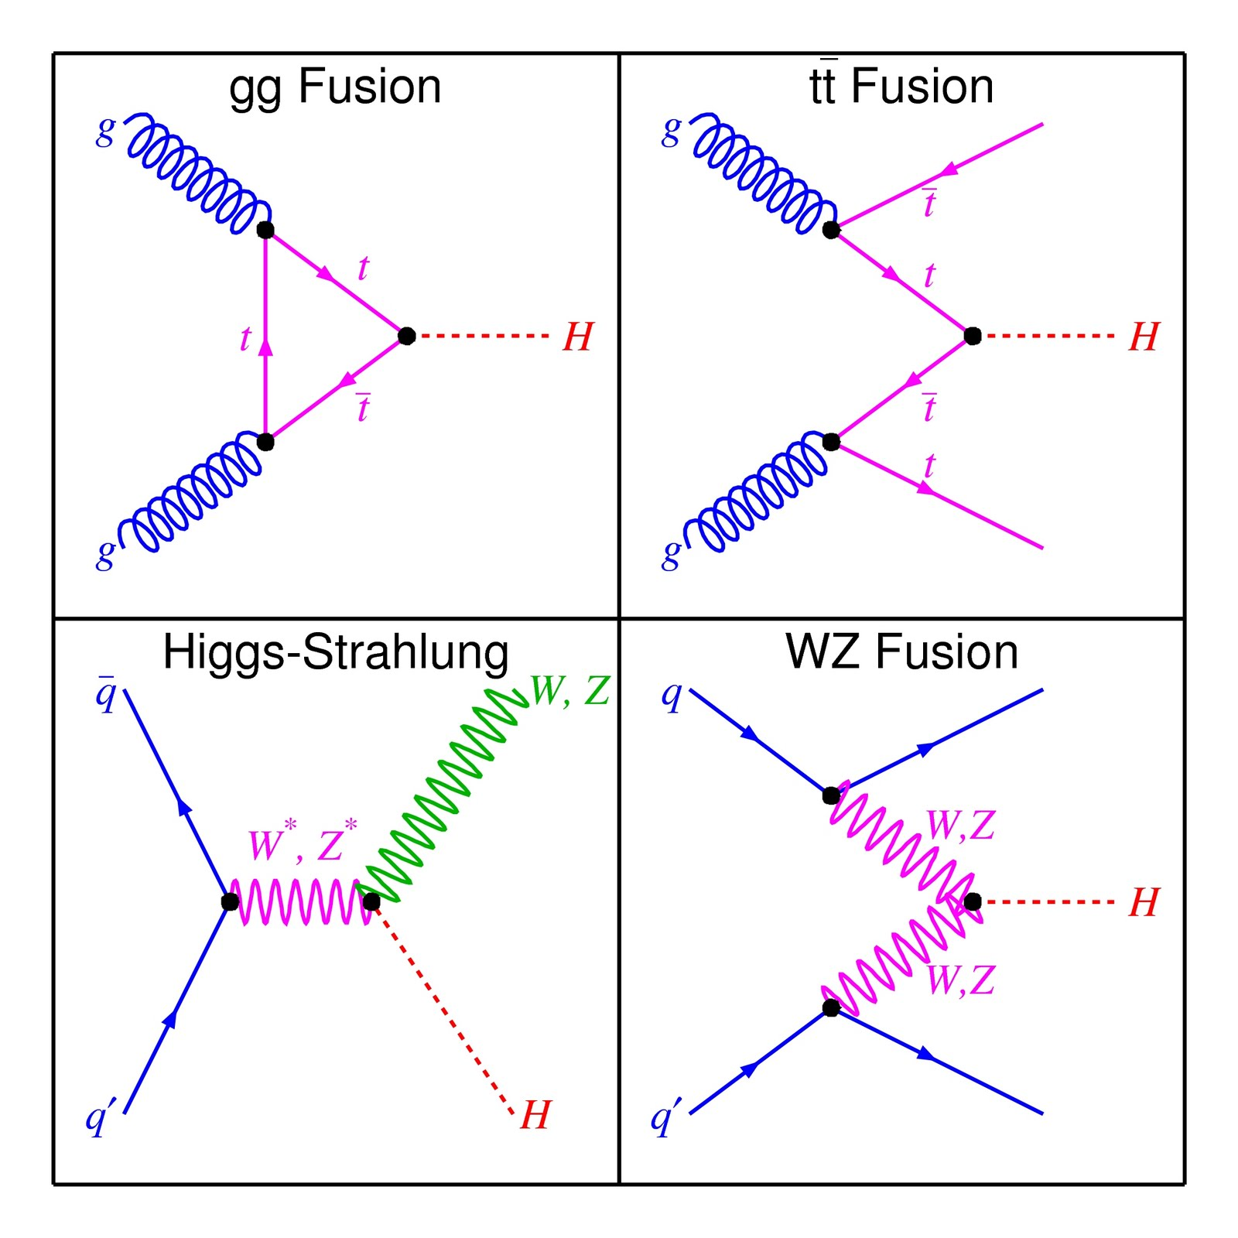
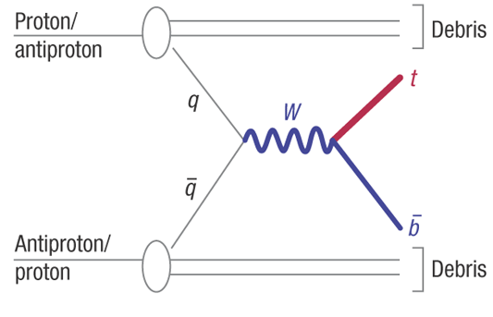
Not so much matter-antimatter but (Vector-Boson) Fusion!
VS

Slide 16
Interaction Rate and Cross-section
At 14 TeV and using Higgs mass 125 GeV.
ggF (gluon-gluon fusion) | 50.35 pb (picobarns)
VBF (vector boson fusion) | 4.172 pb
WH | 1.504 pb
ZH | 0.8830 pb
ttH | 0.6113 pb
bbH | 0.5805 pb
Ref: HiggsEuropeanStrategy
Previous slide, making about 2 fb^-1 (inverse femtobarns) of luminosity every week, get the units right, then making Higgs by ggF is 50,350 fb * 2 fb^-1 or 100,700 Higgs via that channel every two weeks!
Barn is an (effective area) of 10^-28 m^2 about the physical size of a nucleus. Depending on energy and details, nuclear effects have cross-sections of 1 to 10^6 barns.

Slide 17
Links
https://home.cern/topics/large-hadron-collider
https://timeline.web.cern.ch/timelines/The-Large-Hadron-Collider
https://op-webtools.web.cern.ch/vistar/vistars.php?usr=LHC1
http://demonstrations.wolfram.com/HowTheProtonAndNeutronGotTheirMasses/
http://pdg.lbl.gov/
aa

Slide 18
Backup

Slide 19
LHCParameters
Circumference | 26659 m
Dipole operating temp | 1.9 deg K
Main RF frequency | 400.8 MHz
“Bucket,” 1/frequency | 2.5 ns
Energy per beam | 6.5 TeV, operating
Dipole Magnetic Field | 7.7 T
Ions Energy per nucleon | 2.56 TeV/n = 6.5*82/208 (Pb-208)
no. of protons | 1.2e11 per bunch
no. of bunches | <= 2604/2748
bunch length, 4sigma | 1-1.25 ns
bunch size, x & y at IP, 1 sigma | 52 x 66 microns
Ref: www.cern.ch

Slide 20
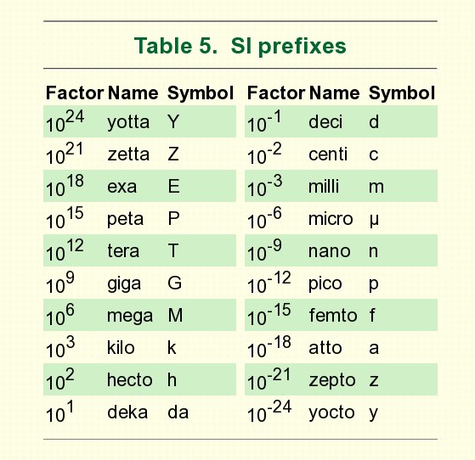
SI Prefixes

Slide 21
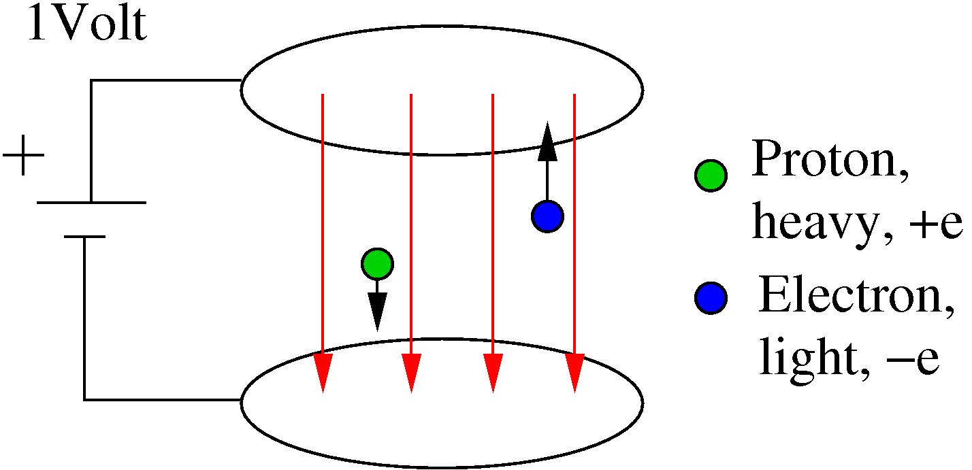
Units?

Slide 22


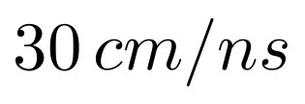
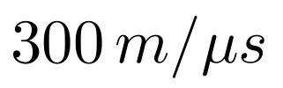

Speed of Light
Fastest possible speed is the speed of light
in vacuum.
Defined as

