Slide 1
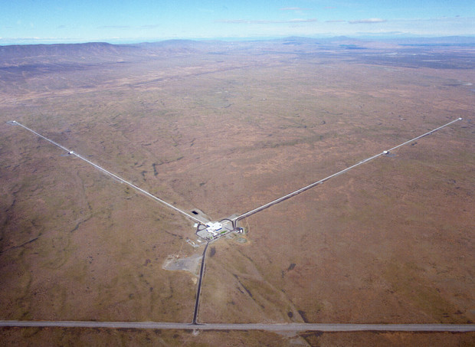
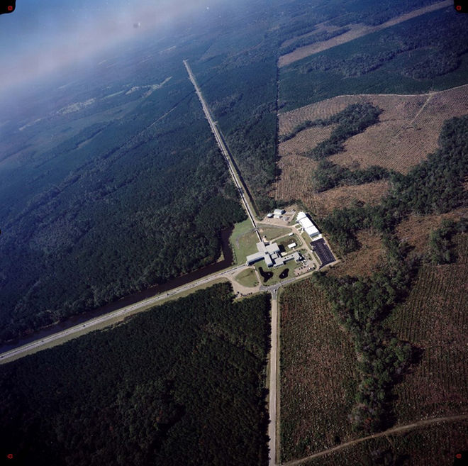
LIGO, ground-based Gravitational Wave Detectors
LIGO Livingston, LA (LLO)
LIGO Hanford, WA (LHO)
LIGO – Laser Interferometric Gravitational Wave Observatory
LSC – LIGO Scientific Collaboration, includes VIRGO (Italy) team, maybe India

Slide 2
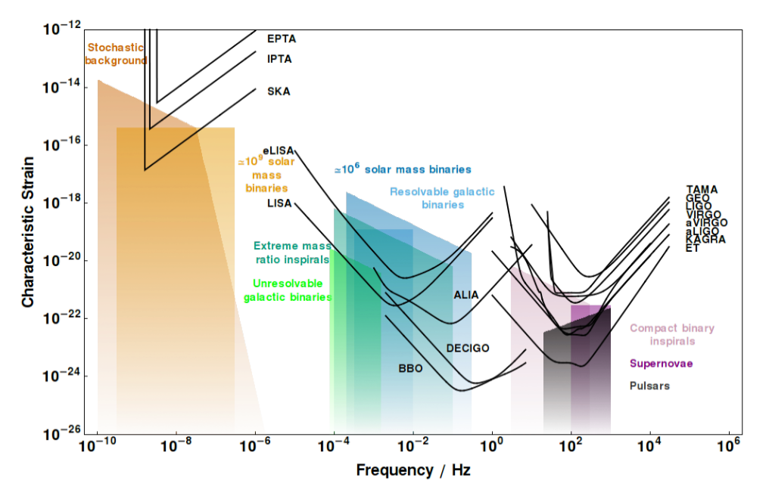

Strain Curves from Moore et al.
Pulsar Timing Arrays
Spaced-based
Ground-based
1pc
30km
wavelength, m
3e16
3e12
3e8
3e4
Notes:
http://www.ast.cam.ac.uk/~cjm96/noise_curve.pdf

Slide 3
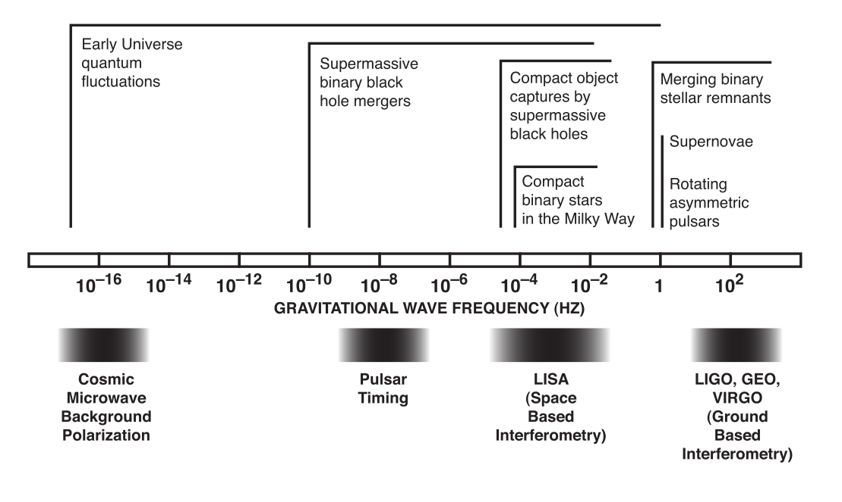
Gravitational Wave Spectrum

Slide 4
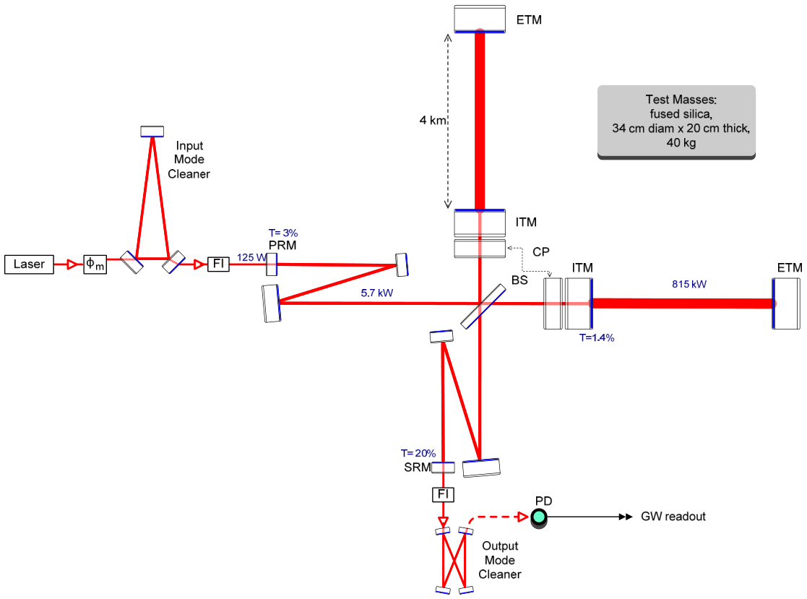

Slide 5
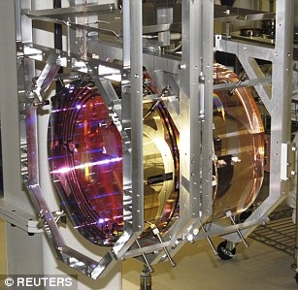
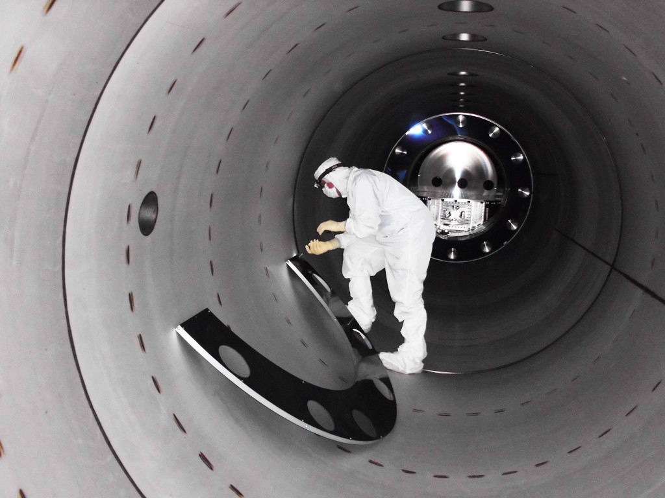
LIGO Hardware
LIGO “Test Mass” in 4-element suspension
LIGO Vacuum Tube
Ref: some hardware images

Slide 6
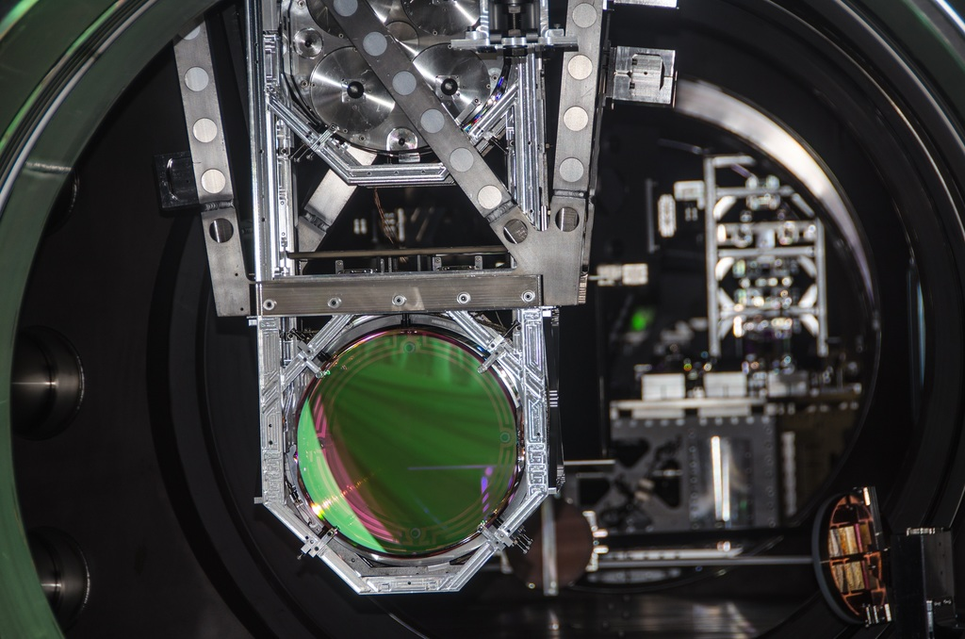
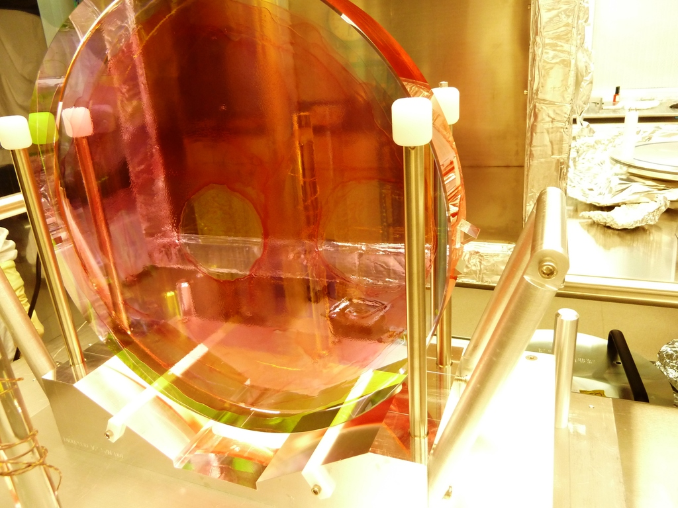
LIGO Hardware
LIGO “Test Mass” in suspension
Beam Splitter

Slide 7


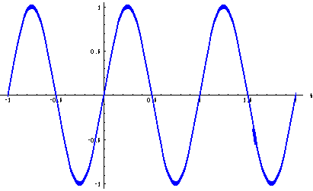
Interference
Two arms, slightly different lengths, L and L+∆L, consider the amplitudes coming together.
Single amplitude like
Sum them together for

Slide 8



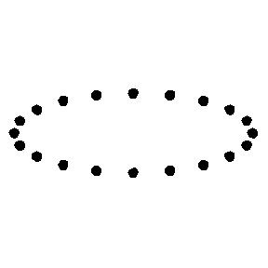
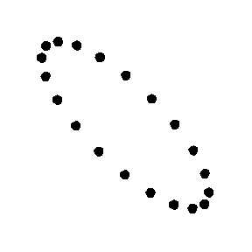
Nature of Gravitational Waves, and
Of all 10 possible components to h, it simplifies to two polarizations. One with a motion that shrinks (grows) in one direction while growing (shrinking) in the other direction. The other polarization is just rotated by 45 degrees.
hplus polarization
hcross polarization
Wave headed into the page, Y up, X right.

Slide 9
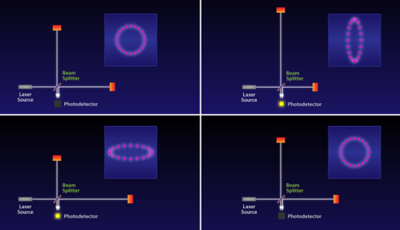
Effect of a perfectly aligned wave on LIGO

Slide 10
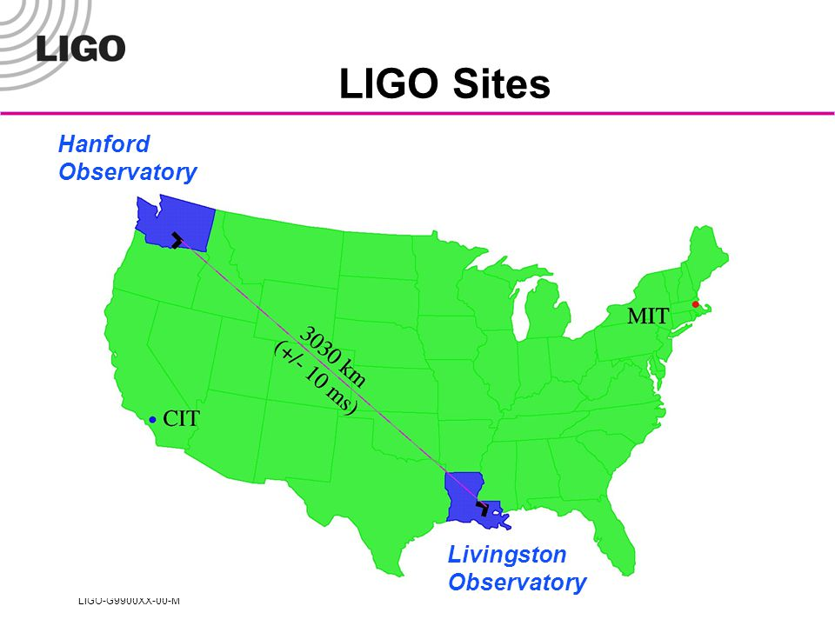

Slide 11
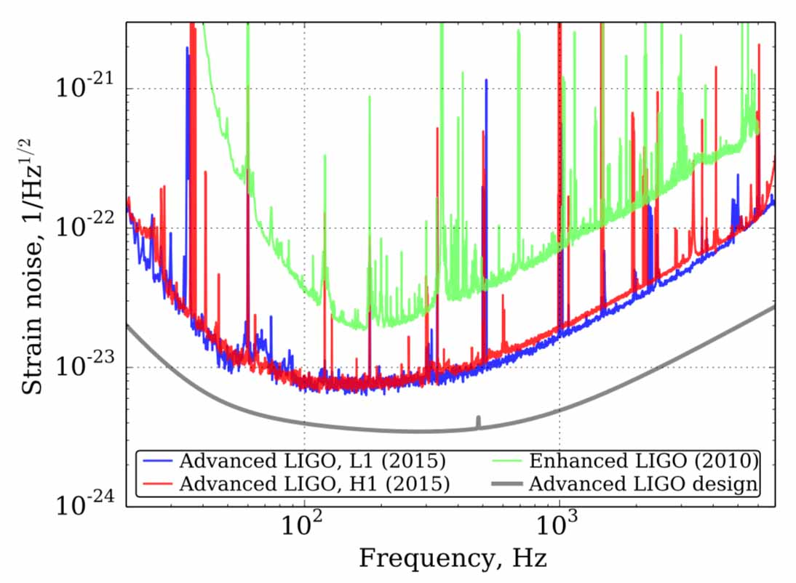
Seismic Noise aLIGO and initial

Slide 12
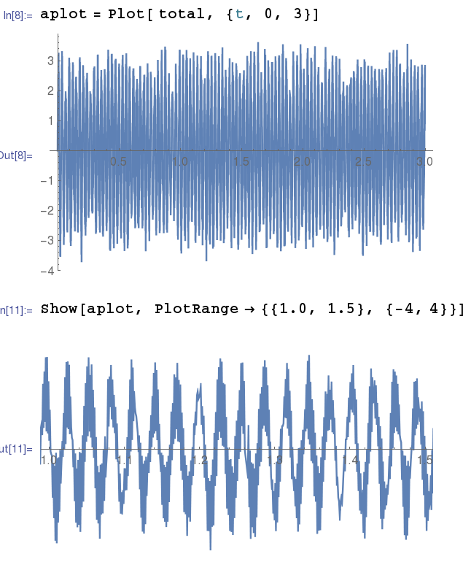
Pick out the Livingston Peaks in Above
Pick out the largest peaks, reconstruct the
possible noise.
Assumed at t=0 all the modes are in phase.
strain, 1e-21
0sec
3sec
3.0
strain, 1e-21
-3.0
1sec
1.5sec

Slide 13
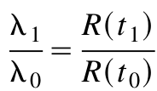
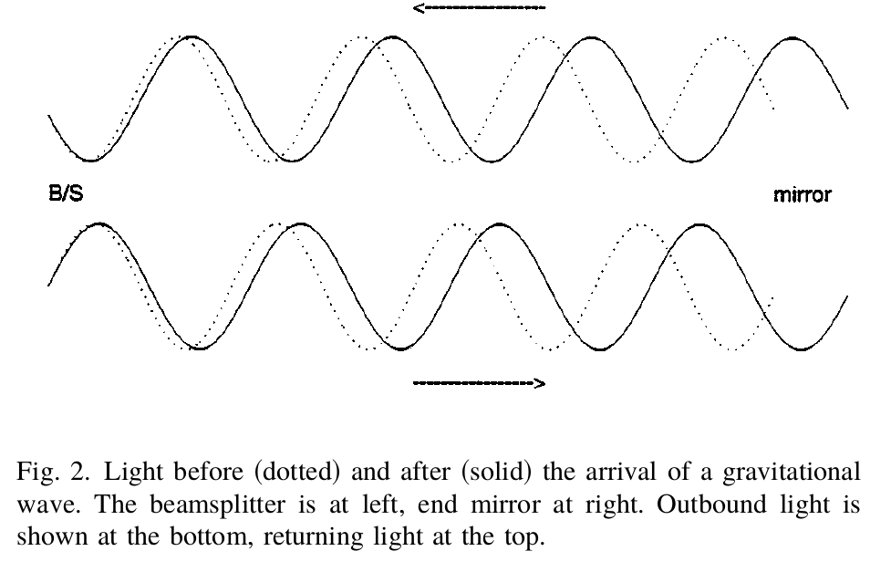
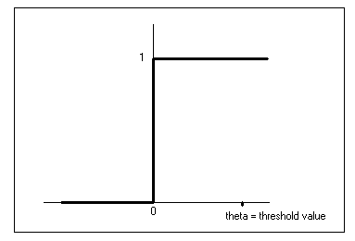
Saulson, If Light Waves…
Argues that in the expanding Universe, light continuously experiences the increase in scale by expanding continuously itself.
NOT the case for a light wave in LIGO...
  The wave filling the cavity IS stretched by the sudden onset of the gravitational wave.
  Light travel time, 2x4km is 27μs,
  but GW oscillates at 20 Hz, 50ms.
h_0
ΔL
time
Ref: Saulson, If Light Waves…, AmJPhys 65, 501 (1997)

Slide 14
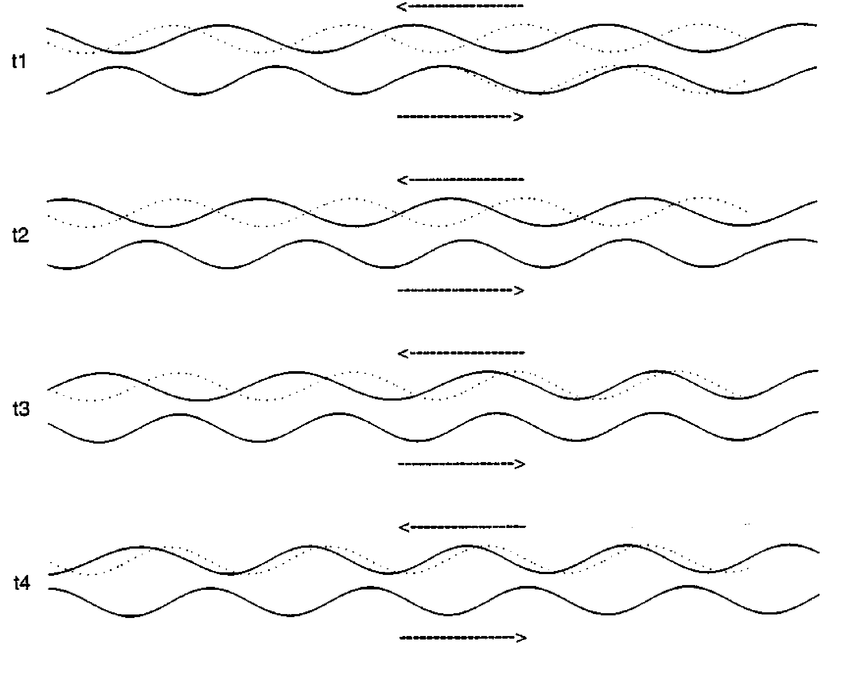
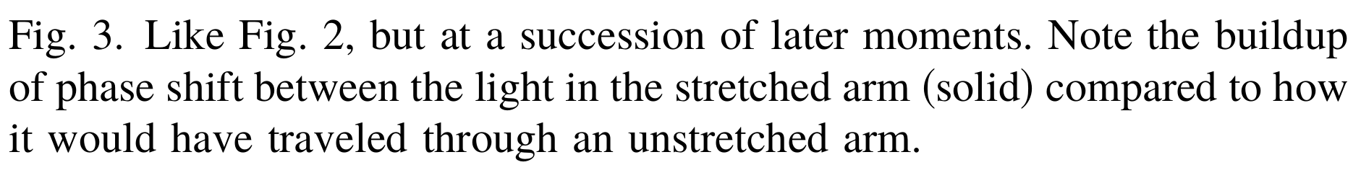
As the Wave runs through...
ΔL
bb

Slide 15
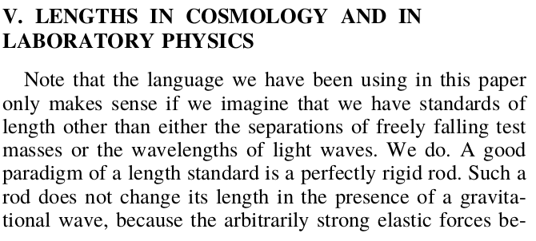
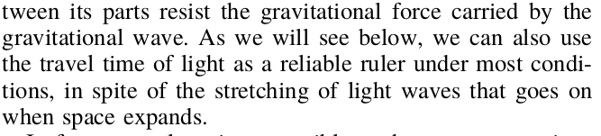
Saulson, If Light Waves…, says rods are still rigid!

Slide 16
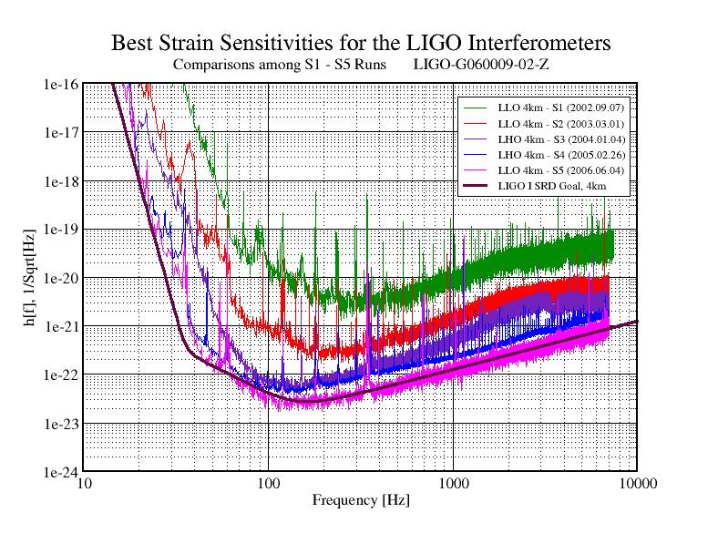
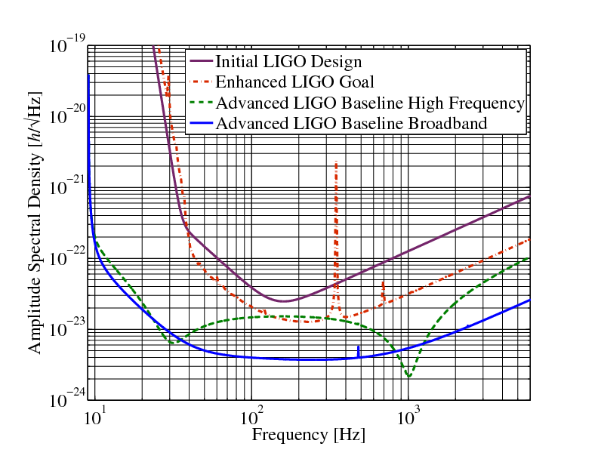
Strain Curve, Strain Sensitivity, Amplitude Spectral Density, Power Spectral Density...OH MY!
“per root Hz” is usually called the strain sensitivity, or sometimes amplitude spectral sensitivity

Slide 17
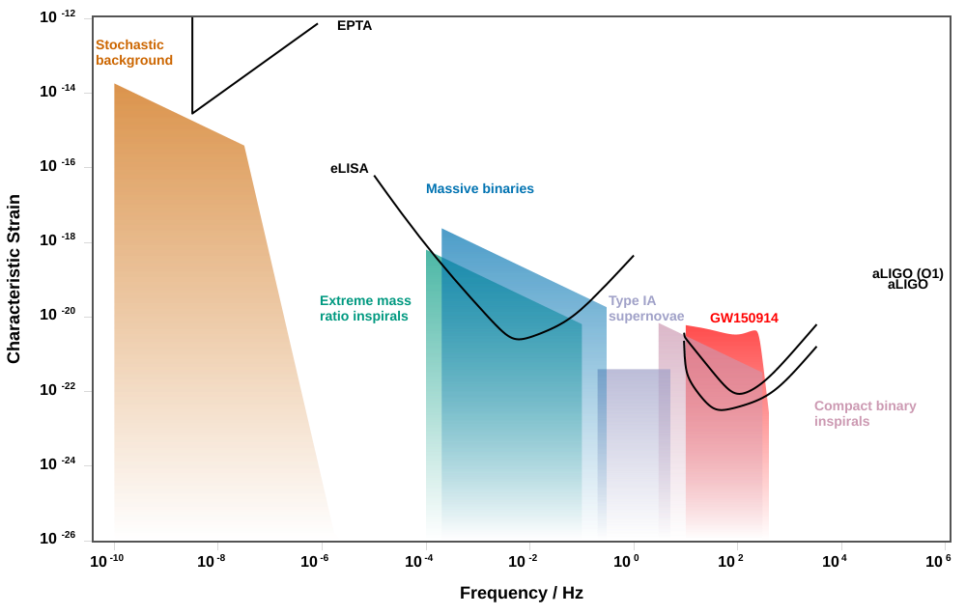
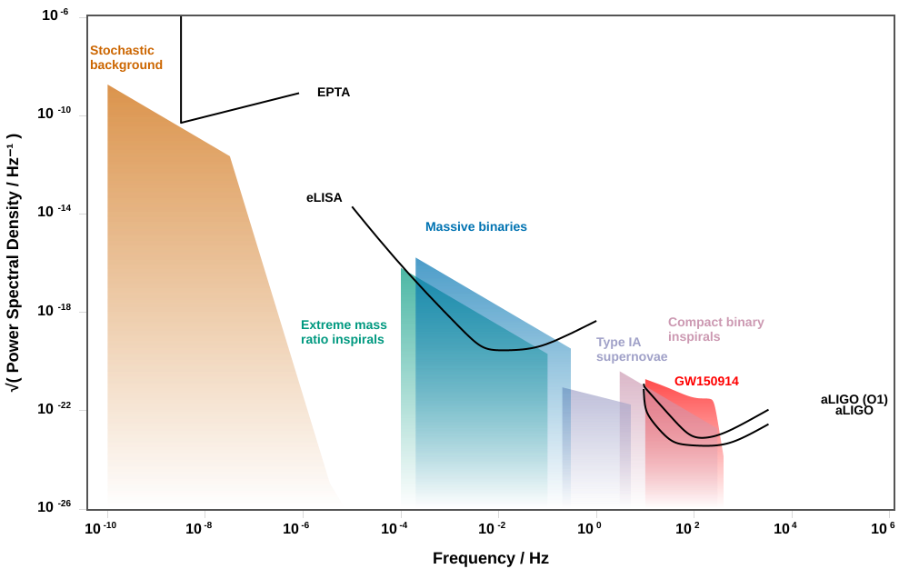
Strain Curve, etc...
Characteristic Strain, just h
square root of Power Spectral Density, really amplitude spectral density
Ref: Cole,s online app .

Slide 18
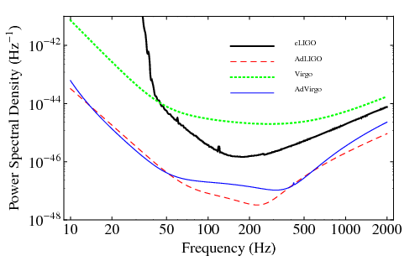
Strain Curve, etc...
Power spectral Density
bb

Slide 19
Links
LIGO Scientific Collaboration, LSC
LIGO Document Server
CalTech GW media assets page.
Kelly Holley-Bockelman’s TEDx Nashville Talk 2016 about GW150914.
Pulsar timing array, Nanograv

Slide 20
Backup

Slide 21
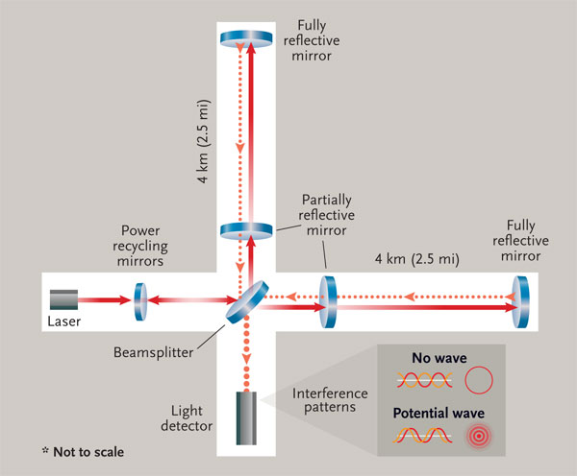
LIGO Inteferometer
4km long

Slide 22
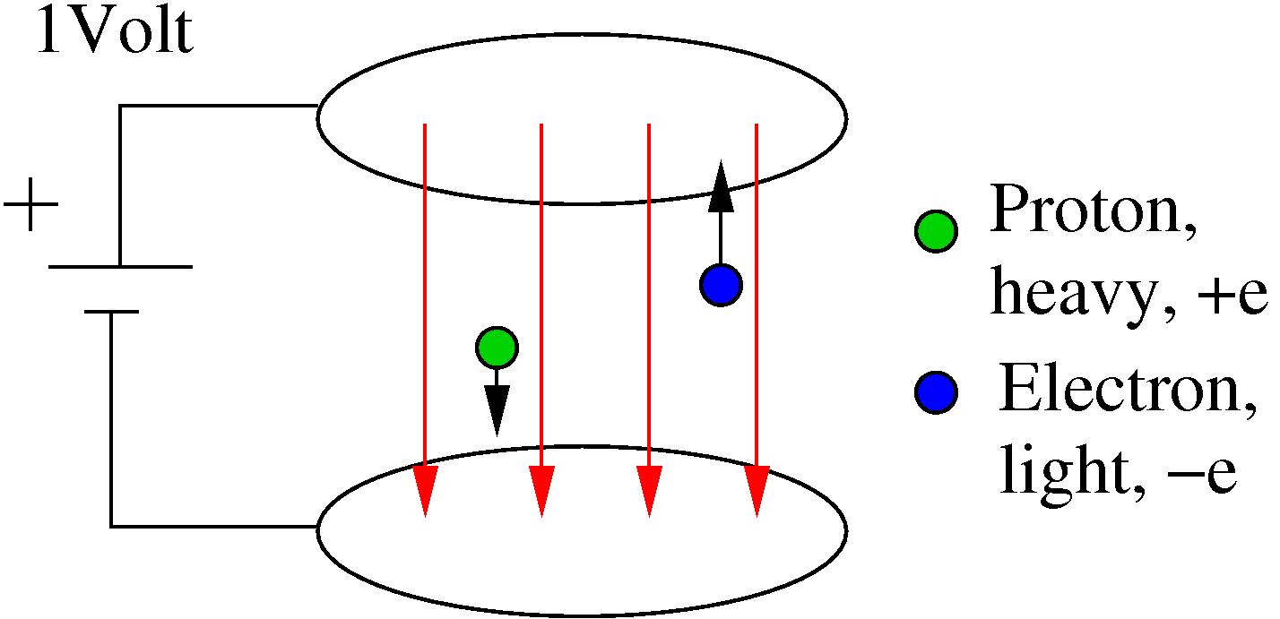
Units?

Slide 23
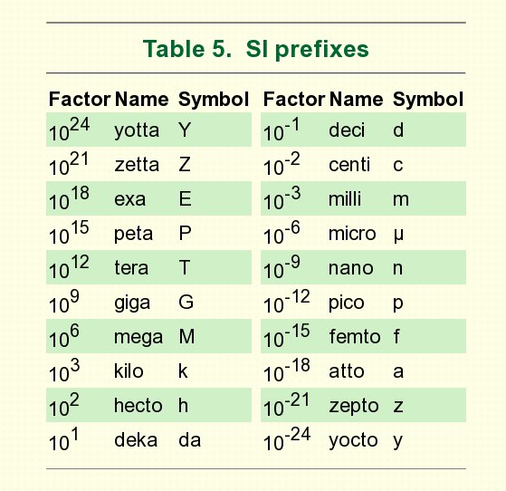
SI Prefixes

Slide 24
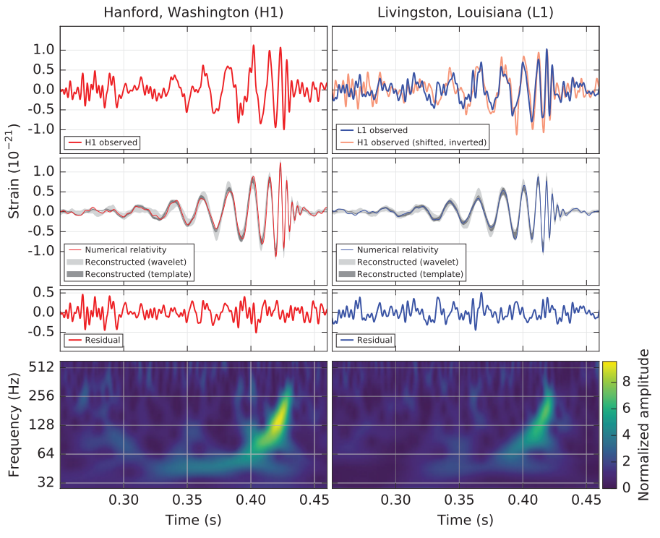
Gravitational Wave GW150914
Direct Discovery by LIGO of a gravitational wave announced on 11 February 2016 for a wave on 14 September 2015---event labeled GW150914.
SNR = 24, 5 sigma detection!
Pretty after filtering out the known seismic frequencies.

Slide 25
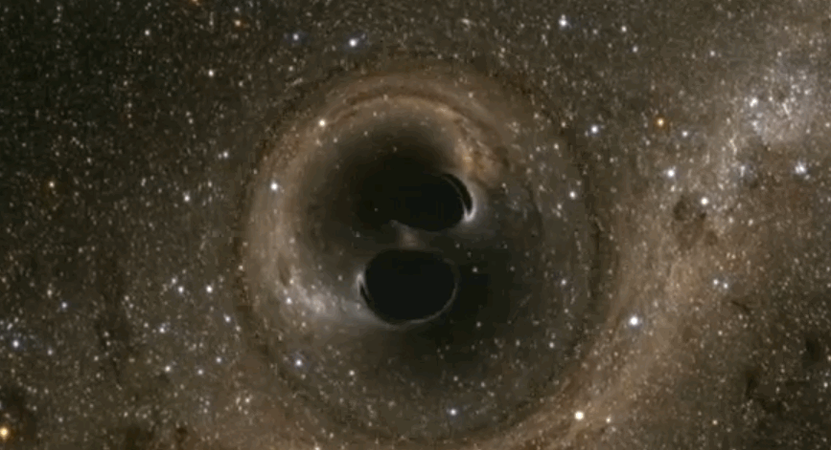
Merging Black Holes
ref: http://www.techinsider.io/binary-black-holes-confirmed-gravitional-waves-2016-2

Slide 26
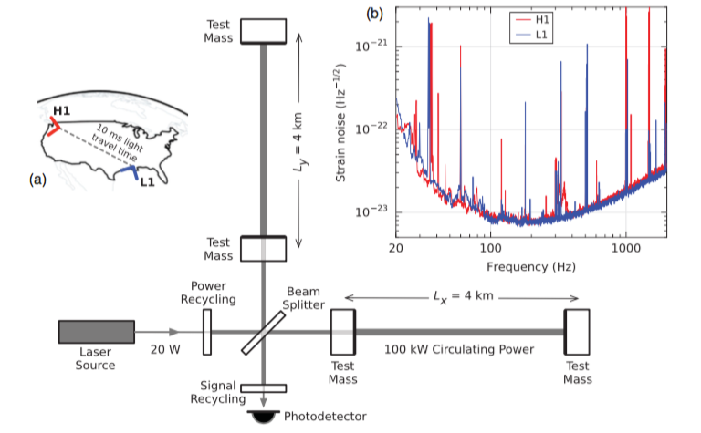
Schematic, Map, and Noise

Slide 27
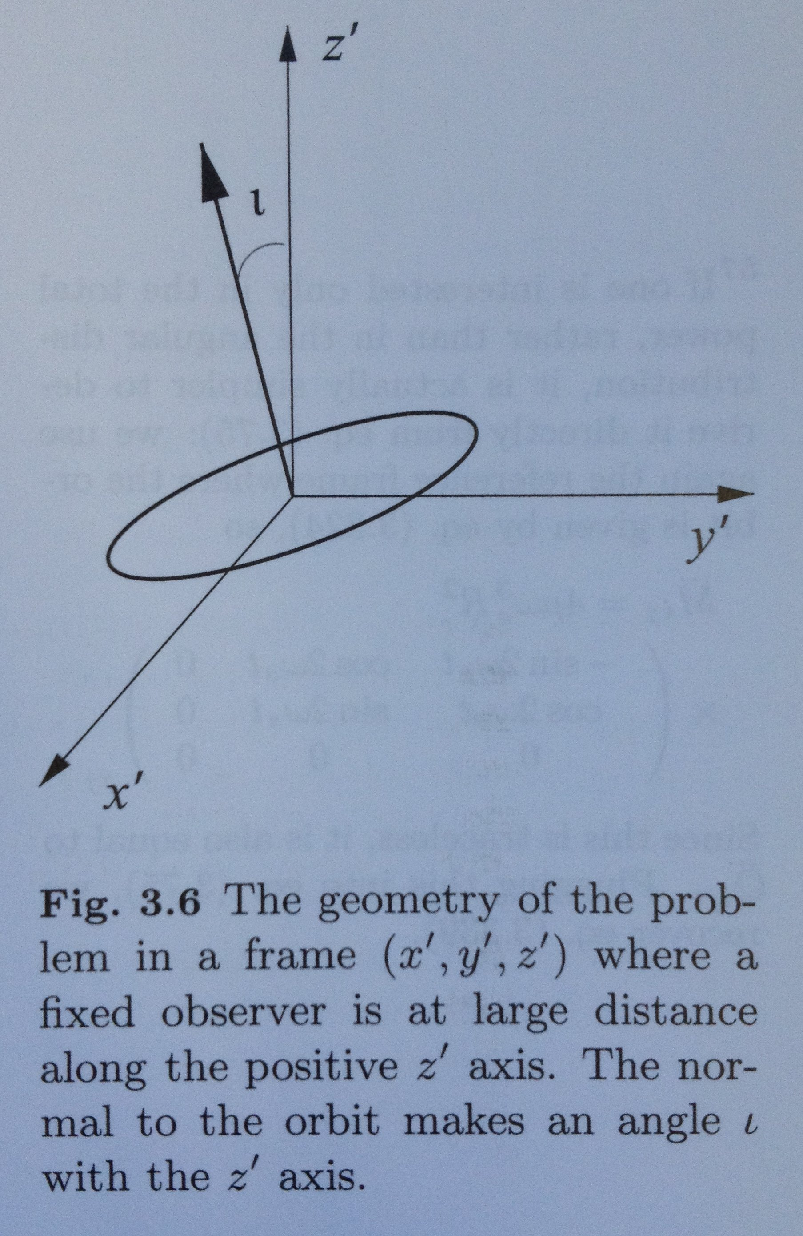

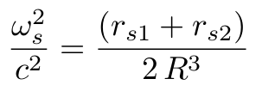


GW strain for Circular Orbit
rs1 is 2GM_1/c^2, Schwarzschild radius for
mass M_1, etc.
r is distance from Earth to system.
R is the separation of the two bodies.
ref: Maggiore around Eqn. 3.332.

Slide 28
Some Constants
Schwarzschild radius | 2GM/c^2 | 2953 m for Msun
GR Units, Mass | GM/c^2 | 1477 m for Msun
GR Units, Power | c^5/G | 3.628e52 W
GR Units, Energy | c^4/G | 1.210e44 J/m
parsec, pc |  | 3.09e16 m = 3.262 ly
astronomical unit, au |  | 149.6e9 m
light-year, ly |  | 0.946e16 m = 0.307 pc
fine structure constant | e^2/(4pi eps0)/hbar c | 0.00730 = 1/137.04
wavelength-energy | h c | 1.24 eV μm

