Slide 1
Quarknet 2016 - Vanderbilt University
25-29 July 2016
Welcome!
The week in a nutshell:
Monday Morning, news and talks
Monday Afternoon, talk Gravitational Waves, Sources and Detectors, login to eLab
Tuesday & Wednesday, Ken Cecire, tutorial on LIGO seismometer array and LIGO eLab
Thursday, day trip to Huntsville (bring drivers license)
Friday Morning, demos and debrief

Slide 2
Administration
Introductions around the room.
Make sure you check the day on the attendance sheet. It is how the stipend will be calculated. Check it and sign it your last day in attendance.
We have three working sets of cosmic ray muon detectors (CRMDs) and have old, but nice laptops for datataking and control. We have a fourth set with non-standard (small) scintillator paddles.
Using the “standard” Java program Equip to control the boards/detectors.
Marshall Space Flight Center wants copies of driver’s license for those going on the bus tour.

Slide 3
Monday Schedule
news and talk
8:00-8:30am arrive, parking permits for the week, check the attendance sheet
8:30-8:45am the weeks schedule, Bill Gabella
8:45-9:15am CERN's Large Hadron Collider, Bill Gabella
9:15-10:15am CMS Physics and Computing, Andrew Melo
10:15-10:25am break
10:25-11:25am Cosmology and Large Scale Surveys, Andreas Berlind
11:25-12:25pm CMS and upgrades, Will Johns
12:25pm-1:30pm Lunch
gravitational waves
2:00-3:00pm Gravitational Waves, Sources, & Detectors, Bill Gabella
3:00-3:30pm Check eLab logins for LIGO, checkout CRMDS and Equip (Java) program

Slide 4
Tuesday and Wednesday Schedule
Quarknet LIGO/Gravitational e-Lab with Ken Cecire (Fermilab)
See the agenda at: https://quarknet.i2u2.org/content/ligo-e-lab-workshop-vanderbilt
Tuesday
8:30-9:00am Arrive
9:00-noon Work
noon-1:00pm Lunch
1:00pm-4:30pm Work
Wednesday
8:30-9:00am Arrive
9:15-noon Work
noon-1:00pm Lunch
1:00-3:00pm Work

Slide 5
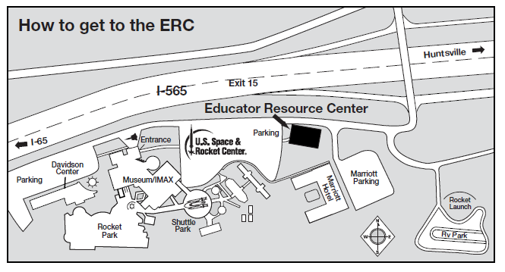
Thursday Schedule
Day Trip to Huntsville, Space and Rocket Center with 12:30pm Bus Tour, BRING DRIVER’S LICENSE and for tour must be a US Citizen
9:00am Arrive at the Educator Resource Center in the Education Training Facility, 1 Tranquility Base, Huntsville, AL 35805
9:15am Overview of the Center, Scott Anderson
9:30am SLS Presentation and Discussion, Kimberly Robinson
10:30-11:15am Walking tour of USSRC, Scott Anderson
11:15-12:15pm Lunch
12:00pm Check-in for Bus Tour
12:30pm Bus Tour of Marshall Space Flight Center, up to 2 hours, restroom facilities limited
5pm? Bill thinks he wants to stay until dinner in the local area; Center closes at 5pm.

Slide 6
Friday Schedule
Flexible day
9:00-noon Assemble Gravity demonstrations with Terry King
noon-1pm Lunch
1:00-3:00pm Cosmic Ray Muon Detector and Closeout

